Slide 1

LF Network Meeting
Wed 24th September, 2018
UNCC, Addis Ababa, Ethiopia

Slide 2

Footwork -
…brings together public and private partners to support prevention and treatment of podoconiosis
…encourages integration of podoconiosis control into efforts to eliminate other Neglected Tropical Diseases
…works with those active in other related diseases of the foot
…is a project of the US-based Social Good Fund, a 501(c)(3)
Our shared goal is to eliminate podoconiosis within our lifetimes.
https://podo.org/

Slide 3
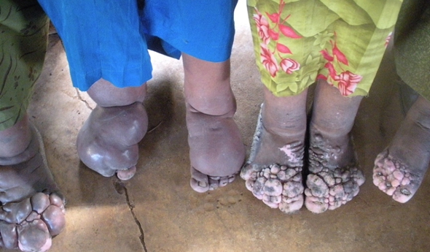
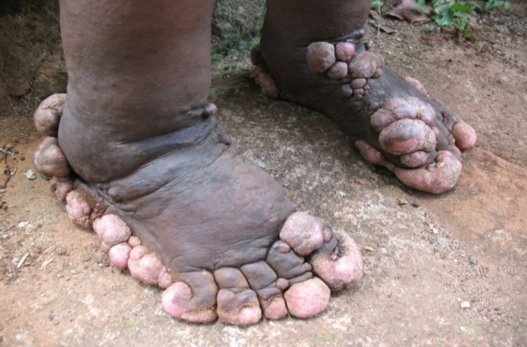
Podoconiosis
A non-infectious geochemical lymphoedema of the lower limb.
Characterised by progressive bilateral but often asymmetric swelling of the lower legs.
The second principal cause of tropical lymphedema.
Found among people with long-term barefoot exposure to red clay soil of volcanic origin.
Recognized as NTD by WHO in 2011.

Slide 4
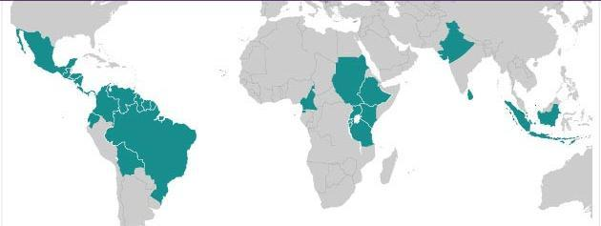
Countries and activities
Guatemala
Ethiopia
Cameroon
Uganda
Rwanda
Burundi
Health professional training;
Advocacy workshops;
Implementation.

Slide 5
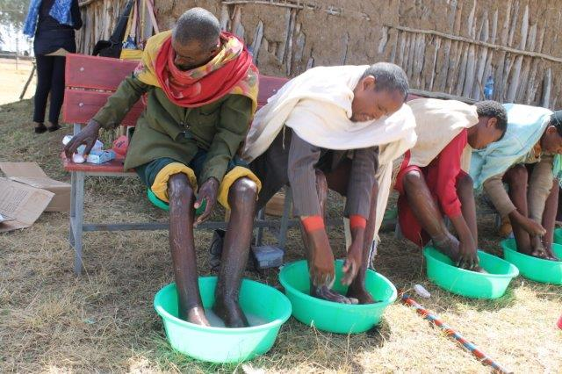
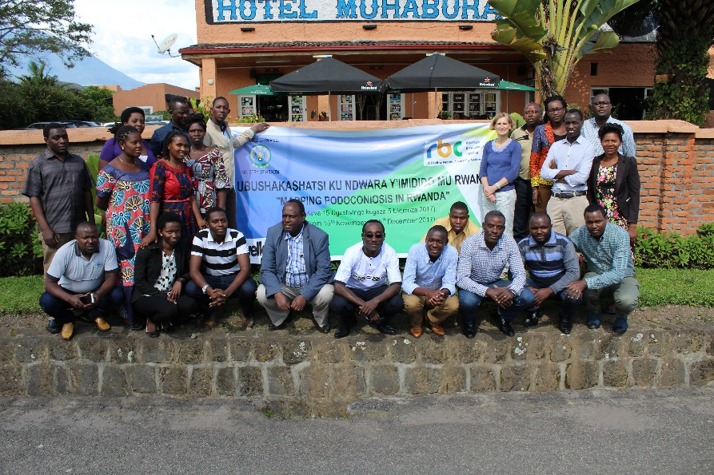
2017-18 achievements
Secured follow-on funding from Izumi for 2 years’ implementation (health professional training and patient care) in northern Ethiopia;
Completed country-wide mapping in Rwanda (all 30 districts affected) and made preparations for mapping in Uganda and Burundi;
Launched NIHR-funded programme of research

Slide 6
Potential Challenges
Current situation with WHO is that “management of podoconiosis is included in the morbidity management of lymphatic filariasis (LF)”
(Report of the 10th Meeting of the WHO STAG for Neglected Tropical Diseases, 2017)
While this is welcome, and has led to joint LF-podo programmes, notably the LSTM-DfID funded programme in Ethiopia, it does leave gaps:
Prevention – regular use of shoes (not part of LF morbidity management)
Geographic – countries such as Rwanda, where LF programmes do not exist, but podoconiosis occurs in every district

