Slide 1
LF INTERVENTIONS: MMDP PROJECT
Zeina Sifri
Senior Technical Advisor
Helen Keller International
September 26, 2018

Slide 2
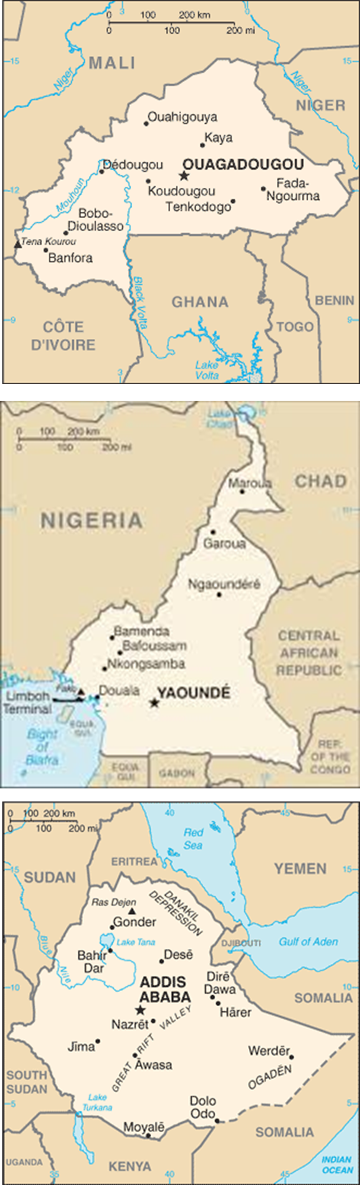
The MMDP Project
The USAID-funded MMDP Project supports high quality TT and LF interventions using preferred practices and develops new and innovative strategies when needed to meet TT and LF elimination goals.
Works with ministries of health and other in-country partners to strengthen the capacity of MMDP systems and scale up MMDP implementation with data driven decision-making.
Develops tools and resources to support the provision of high-quality TT and LF MMDP services.
Supports WHO’s global program and works in partnership with the global community to share knowledge and meet shared goals.

Slide 3
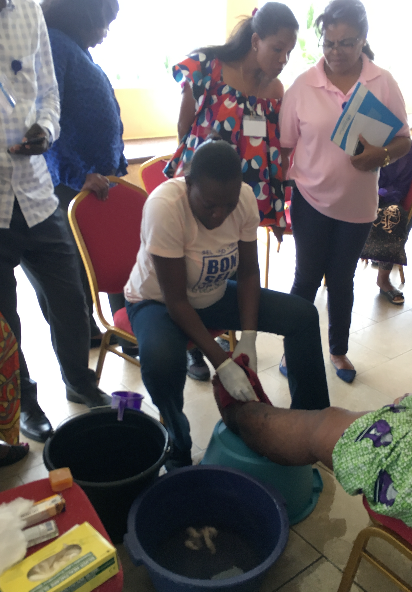
LF INTERVENTIONS - LYMPHEDEMA
Lymphedema Management Training - curriculum
Burden Assessment
Health Facility Assessment
Lessons Learned
WHO LF MMDP Training
Notes:
Cameroon community volunteers with visual guides held information and sensitization meetings. 834 suspected hydrocele cases found. Trainers nurses examined the cases, out of which 300 (36%) were subsequently confirmed by the trained nurses at the health facilities. Of these, for logistical and planning purposes, a total of 95 cases were referred to a district hospital where surgeons trained under the MMDP Project confirmed the diagnosis in all 95 cases and operated on the patients. The remaining 205 registered cases are awaiting surgery. In view of these results, the community-based approach to identify hydrocele cases using community mobilizers and nurses appears to be feasible

Slide 4
Capacity Building
Lymphedema management trainings held to date:
Training Cadre | Burkina Faso | Cameroon | Ethiopia | TOTAL
Health staff trained as trainers for lymph. mgmt | 452 | 93 | 312 | 857
Community health workers/ caregivers trained in lymph. mgmt. | 1,189 | 48 | 0 | 1,237
Patients trained in self-care | 381 | 112 | 1,316 | 1,809
Notes:
Training data as of March 2018 due to project reporting cycles (though only Ethiopia has had additional trainings since then)
207 health staff in Ethiopia were trained in both hydrocele surgery support AND lymph. mgmt. – they are counted twice (once in each category)

Slide 5
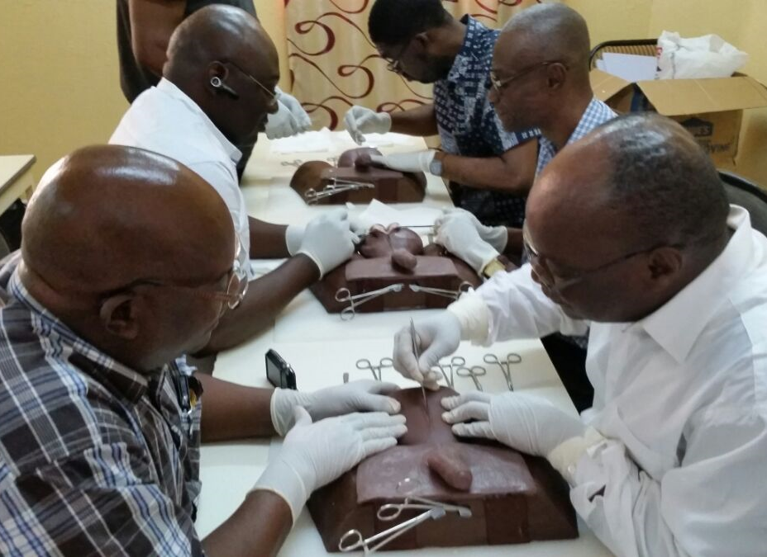
LF INTERVENTIONS - HYDROCELE
  Hydrocele surgery training – FASTT
  Burden assessment
  Obstacles to surgery
  Hydrocele surgery (resection)
  Patient post-operative follow-up

Slide 6
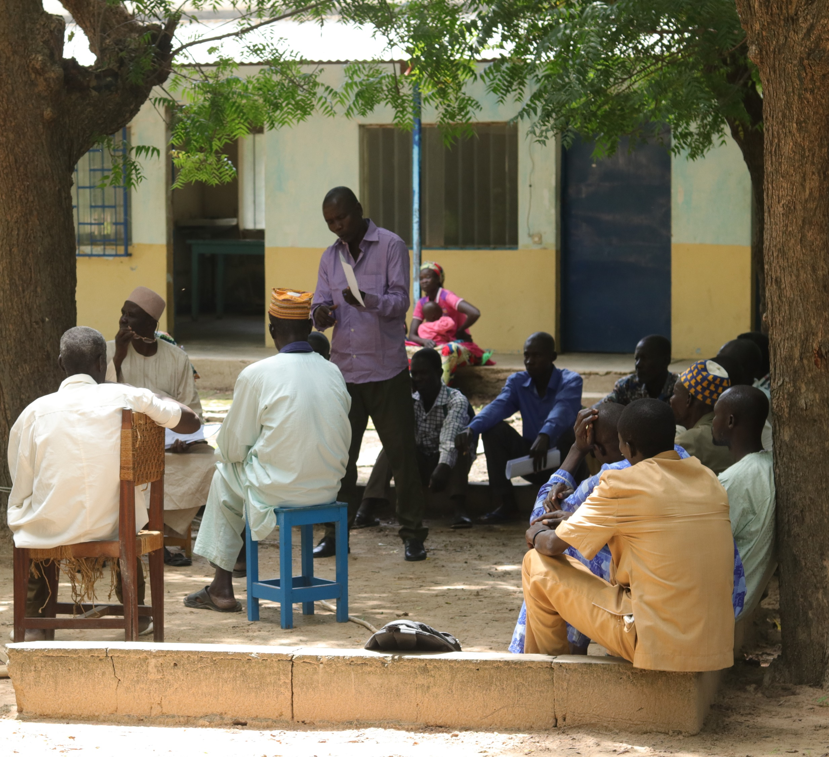
Burden assessment of hydroceles in Cameroon
Community mobilizers trained (visual guides)
Sensitization/patient identification (834 cases)
Trained nurses (300 confirmed cases)
95 cases examined by surgeon (100% confirmed)

Slide 7
Capacity Building
Hydrocele trainings held to date:
Training Cadre | Burkina Faso | Cameroon | Ethiopia | TOTAL
Master FASTT Trainers | 1 |  | 2 | 3
National hydrocele surgery trainers | 3* | 2 | 12 | 17
Hydrocele surgical care providers | 93 | 7 | 27 | 127
Health staff trained in hydrocele surgery support | 55 | 25 | 256 | 336
Notes:
Training data as of March 2018 due to project reporting cycles (though only Ethiopia has had additional trainings since then)
207 health staff in Ethiopia were trained in both hydrocele surgery support AND lymph. mgmt. – they are counted twice (once in each category)

Slide 8
Disease Management
Hydrocele surgery & 6-12 month follow-up to date: (preliminary data)
Country | # hydrocele surgeries | # people receiving follow-up 6-12 months after surgery* | # people with recurrence 6-12 months after surgery | % recurrence 6-12 months after surgery
Burkina Faso | 740 | 276 | 6 | 2%
Cameroon | 106 | 80 | 8** | 10%
Ethiopia | 706 | 63 | Data pending | Data pending
TOTAL | 1,552 | 419 | 14 | 4%**
Notes:
*4% recurrence rate is weighted average between BF and CMR (14 cases of recurrence out of 356 surgeries across the two countries)
Data collection: needs to be integrated into existing processes: 5 day follow-up of hydrocele surgery patients and follow-up of lymphedema patientsSome hydrocele surgeries included in this table are not yet eligible for 6-12 month follow-up (because the surgeries took place less than six months ago)

Slide 9
Next Steps
Hydrocele surgery and follow-up
FASTT Training Package update and dissemination
Integration of lymphedema management training and hydrocele surgery training into pre-service curriculum
Support for dossier development
Publication

