Slide 1
Lymphatic Filariasis Disease Specific Meeting
Disease Management, Disability and Inclusion
MMDP / DMDI Subgroup Update
Linda F. Lehman, OTR/L MPH C.Ped
Senior Advisor for MMDP, American Leprosy Missions
Jan Douglass, PhD
Lymphoedema Consultant,
Centre of NTDs, Liverpool School of Tropical Medicine
Wednesday September 26, 2018
Notes:
Increase and improve DMDI interventions within LF and across NTDs and other health conditions. Brief overview of 1) NNN DMDI Working Group 2) NNN DMDI Survey results 3) Stand care and beyon

Slide 2
NNN Disease Management, Disability and Inclusion (DMDI) Working Group
“Leave no one behind”
Disease Management, Disability and Inclusion (DMDI) reflects a wider concept of interventions which were initially known as MMDP (morbidity management and disability prevention)
It addresses health, well-being and disability inclusion

Slide 3
Purpose of NNN DMDI Working Group http://www.ntd-ngonetwork.org/ - TOR for DMDI
Promote person-centered disease management, disability prevention, stigma reduction and other across NTDs in context of a comprehensive “continuum of care” approach.
Position NTD related DMDI in the wider field of disability (UN CRPD, WHO ICF, IDDC, WHO Rehab 2030)
Promote information sharing
Promote the development and use of evidence-based and/or best practices in the field of DMDI
Promote the implementation of DMDI across NTDs
Notes:
Promote LF to become involved with DMDI and promote inclusion and participation of persons with LF/Podoconiosis within NNN meetings

Slide 4
“Rehabilitation is understood to be a set of interventions designed to optimize functioning and reduce disability in individuals with health conditions in interaction with their environment.” (WHO, 2017)
Interventions are a part of primary, secondary and/or specialty care health services
Interventions in mental-wellbeing and stigma to support emotional needs of people affected by NTDs and engage with communities to reduce social exclusion and discrimination
“Ensure healthy lives and promote wellbeing for all at all ages.” (SDG3)

Slide 5
DMDI – Task Groups
TG – 1 Indicators and Mapping
TG – 2 Interventions
TG – 3 Mental Well-being and Stigma
TG – 4 Participation, Inclusion & Human Rights

Slide 6
NNN DMDI Survey Results
N=18 responses from 14 different organizations
86% organizations LF and Podo
Notes:
More than half or the 14 organizations work with lymphatic filariasis (11) and trachoma (10), followed by leprosy or Hansen’s disease (8), Soil-Transmitted Helminthiasis (STH) (7), Onchocerciasis (6) and Schistosomiasis (6). Fewer organizations responding to the survey worked with Yaws, Buruli Ulcer, Rabies and Guinea-worm disease, Podoconiosis and Leishmaniasis (see Figure 2).
More than 80% of the responses reported combining different NTDs or NTDs with other diseases and health conditions. Combinations varied greatly. The most frequent was preventive chemotherapy (PC) NTDs (lymphatic filariasis, onchocerciasis, STH, schistosomiasis, trachoma and yaws). Intensive disease management (IDM) NTDs were also combined as seen with leprosy, tuberculosis, Buruli ulcer and LF.
Some related integrating NTDs into general primary care and combining with non-infectious diseases such as diabetes and combining with inclusive eye health, mental health within general community based rehabilitation (CBR) and community based inclusive development (CBID) initiatives.

Slide 7
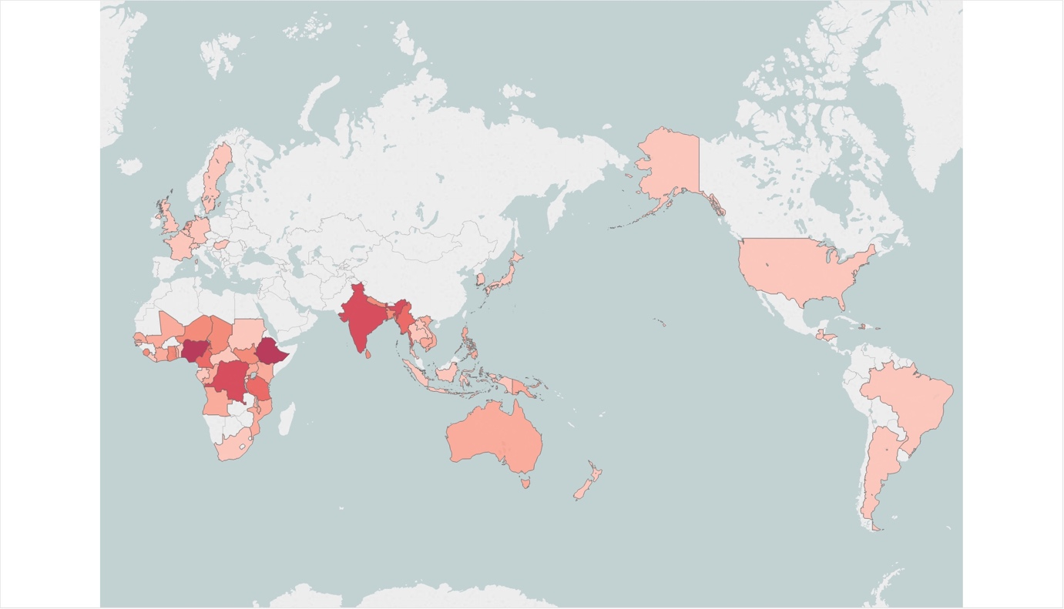
NNN DMDI Survey Results: Number of Organizations by Country Location of their Work
Notes:
The organizations responding to the NNN DMDI survey are supporting and implementing NTD projects and programmes in 60 countries (table 2 and figure 1). The location of their work was predominately in Africa and Asia. The African countries that had four or more organizations were Ethiopia (6), Nigeria (6), Democratic Republic of the Congo (5), Cameroon (4), and Tanzania (4). In Asia, India (5) and Myanmar (4) were represented by four or more organizations.

Slide 8
Care to prevent or reduce oedema/lymphoedema
Notes:
The most frequent interventions organizations use to manage oedema/lymphoedema are self-care, treatment of acute attacks, provision of protective footwear and hydrocele surgery. Few organizations manage urogenital problems or provide compression garments. Fifty percent provided or facilitated access to hydrocele care (see Figure 6).

Slide 9
DMDI Survey Responses: Key DMDI Challenges identified by Survey
“Without an end point” “Chronic” “Expensive”
DMDI lacks funding and is expensive
Resistance from various groups to collaborate with each other
  Between disease groups and disability groups
  Health professionals
  Collaboration between organizations
Focus on prevention vs morbidities
IEC materials and DMDI activities
Training of health workers

Slide 10
DMDI Survey Responses: Causes making it difficult for people with NTDs to access DMDI interventions
“Care packages are not close enough to affected communities and people with disabilities ”
Poverty, costs, limited resources
Attitudes, Knowledge and Awareness about DMDI
Limited Accessibility and Availability to DMDI
Weak peripheral health system, limited support and commitment
Development of capacity at all levels, especially in conflict areas
Notes:
Economical barriers
Poor resources and lack of funding for DMDI activities (3)
Poverty (2)
Cost of access
Chronicity of conditions
Attitudes, Knowledge and Awareness about DMDI
Lack of knowledge and awareness about DMDI options for care (4)
Stigmatizing attitudes from within health systems (2)
Low literacy
Accept work in conjunction with people of different diagnosis
Limited accessibility and availability to DMDI
Limited services (3)
When services exist, they are far, distance (2)
Targeting marginalized and hard-to-reach communities (2)
Care packages not close enough to affected communities and people with disabilities (DMDI working group to assist in developing these with national programs
Time
Weak peripheral health system, limited support and commitment
Weak peripheral systems, policies may exist centrally but are not functioning at district level (4)
The NTD community is not (yet) making all services fully accessible (comprehensive and inclusive)
Competing commitments
Lack of support from Disabled Persons Organization (DPO)

Slide 11
DMDI Survey Responses: What is Needed to Develop DMDI Activities
“Disease specific groups include DMDI into their plans of action”
“Participation of affected communities and individuals through the programs at all levels “
Funding and Budget (13)
WHO and Government Commitment to DMDI and Community Ownership(8)
Clear Guidelines and Inclusion of DMDI Indicators (3)
Other (1)
  Change of mindset (all)
  Expert advice to local programmes
  Improved access to patients in remote areas
  Increase number of professionals trained to develop DMDI work
Notes:
Funding was mentioned by 13 respondents as an essential requirement to implement DMDI activities
WHO and Government to commit to DMDI and community to take ownership and ask for DMDI interventions (8)
Participation of affected communities and individuals through the programs at all levels (HR based approaches)
Political commitment from MOH for DMDI
WHO engagement with DMDI and overcoming the PCT DMDI LEP divisions (out of the silos work),
Disease specific groups to include DMDI into their plans of action (and where possible into their elimination criteria, see TRA and LF)
Strong connections and reporting between MOH and private care facilities
Evidence that DMDI works and that it can have positive measurable impact on elimination goals and indeed is essential towards the endgame characterised by mainstreaming and institutionalisation of NTD services into the general health system for sustained success
Health education for people to understand the benefits of the services provided
Clear guidelines and inclusion of DMDI indicators (3)
Develop guidelines
Include DMDI indicators into the UTC score card as well as the SDGs NTD indicator
Build the capacity of implementers
Expert advice to local programmes
Increase number of professionals trained to develop DMDI work
Other
Change of mind-set (16)
Improved access to patients in remote areas

Slide 12
THE FUTURE for MMDP/DMDI sub-group in LF
Going beyond the “minimum package” in LF
Participation in NNN DMDI working group
New MMDP LF sub group coordinator: Jan Douglass
Enhance morbidity management through two-staged approach for interventions
Integrate morbidity management
Morbidity targets (leprosy): early, stage and child data
WEBINAR possibilities:
  Review of basic lymphatic physiology
  Learning from best practices in other forms of lymphoedema
Notes:
Adding to standard care (hygiene, elevation, acute attacks, footwear) as it is not as effective in advance stages of Lymphoedema. Adding daily massage, breathing exercise, additional exercises, diet (fresh fruit and vegetables) and fresh water intake). Compression?

Slide 13
THANK YOU

