Slide 1

Lymphatic Filariasis (LF)
Non-Governmental Development Group (NGDO)
Dr Louise Kelly-Hope, Chair LF NDGO Group

Slide 2
LF NDGO Network
Aim of facilitating integration and collaboration among NGDOs supporting LF elimination
Objectives:
  To serve as a forum for information sharing, collaboration, and communication
  To provide LF technical input, on tools, resources, meetings, workshops, other important initiatives
  To provide technical guidance and support to the NNN on LF-related discussions and initiatives, with the goal to achieve 2020 targets
  To serve as the link between the NGDO community to the GAELF, and help amplify the advocacy and communication efforts

Slide 3
LF NDGO Network
Past Chairs
Susan Girois (Handicap International), Jose de La Cruz (LEPRA), Pierre Brantus (Handicap International), Ann Varghese (IMA World Health), Emily Toubali (HKI), Molly Brady (RTI) and Yao Sodahlon (MDP)
Current Chair: Louise Kelly-Hope (CNTD/LSTM)
Vice Chair: Maartje Pronk (LEPRA)
Immediate Past Chair: Yao Sodahlon (MDP)
LF - Oncho sub-group lead: Charles Mackenzie (TFGH)
LF - MMDP sub-group lead: Jan Douglass (CNTD/LSTM) Linda Lehman (ALM) *
London Declaration Scorecard Working Group rep: Francisca Olamiju (MITOSATH) Molly Brady (RTI)*

Slide 4

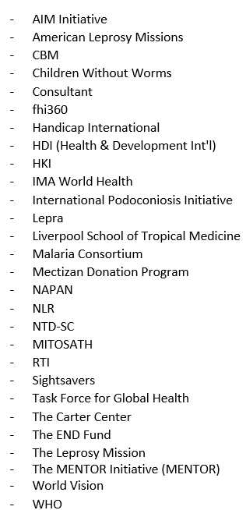










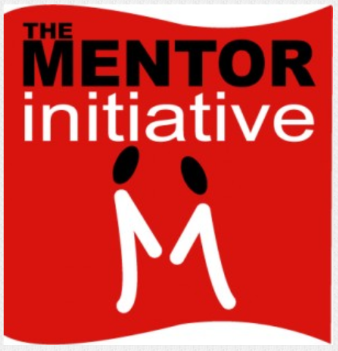



















Institutions / Organizations
- Uniting to Combat NTDs
Notes:
Indian Network LF MMDP program

Slide 5
Survey - NNN workshop themes
MDA
Working together to bridge MDA gaps in target communities / getting coverage everywhere
Workshop on the scale-up of Triple Drug (IDA) MDA
Coordinating LF and oncho / stopping MDA in Africa for the endgame
Improving community participation during MDA through drama and public engagement
MMDP
How LF programmes are strengthening the health system to provide patient care
Good care practices by the person affected, their family and community to sustain disease prevention and improve quality of life
Workshop on training modules, presentation of the tools and experiences using them
WHO requirements for the MMDP component of the dossier
Hydrocele surgery technical and programmatic updates

Slide 6
Survey - NNN workshop themes
Other
Strengthening capacity in integrated vector management
Impossible to reach? NTDs in Conflict and Emergency Settings
What will be the target post-2020?
How to deal with programme fatigue?
Country examples of achieving sustainable post-MDA surveillance
NTDs and cross border situations
Research priorities

Slide 7
Survey - LF NGDO group
MDA / surveillance
Urban MDA update
Following up on LF positive cases identified in TAS
Conducting Pre-TAS/TAS in areas where oncho is still being treated
Lessons learnt of countries in post-MDA surveillance phase - examples of sustainable, cost-effective
Role of IVM and xenomonitoring in post MDA surveillance phase
MMDP
Review, reflections and engaging government in provision on minimal package of care
Morbidity management in low prevalence areas/countries
Lymphoedema surveillance beyond ' LF elimination’ / post-elimination patient management
Integration of MMDP components across diseases
Other
Current role and contribution of LF NGDO to the GPELF
NDGO/Partner mapping and identifying GAP countries

Slide 8
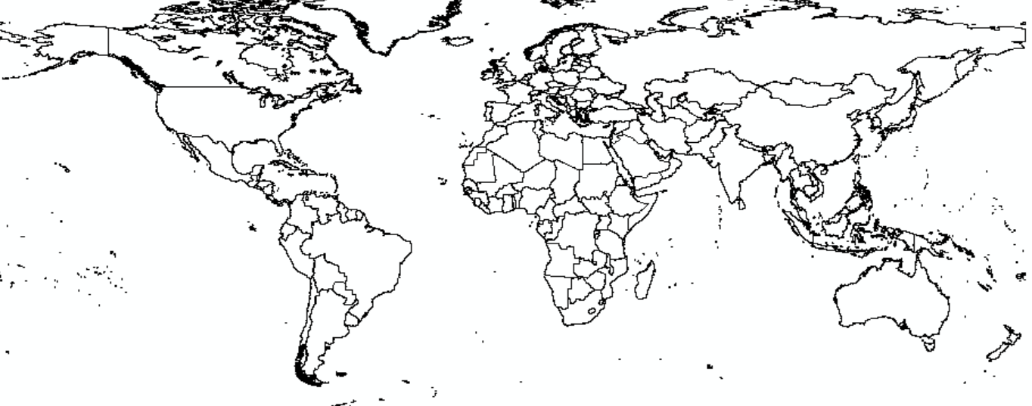
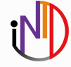
NGDO partner mapping ‘in development’

Slide 9
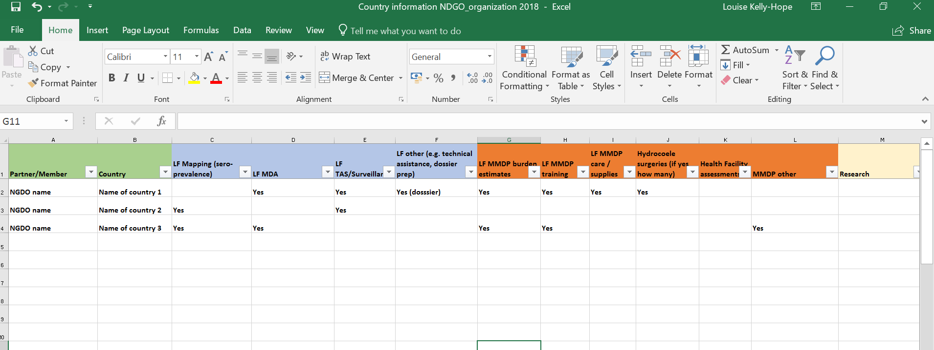
NGDO partner country information – example spread sheet
Transmission
LF endemicity mapping
LF MDA
LF TAS
LF other
Morbidity
LF Burden estimates
MMDP training
LF supplies / Hydrocoele surgeries
Facility assessments

Slide 10
Acknowledgments
Survey Respondents from following NGDOs
Assistance with survey and data collation
Dr Jan Douglass
Dr Kapa Ramaiah
Provision of information on NGDO specific activities
AIM Initiative – Anna Wickenden, Tia Akpan
ALM - Linda Lehman
CBM – Martin Kollmann, Nick Burn & Johan Willems
ENDFUND - Kimberley Kamara & Warren Lancaster
Footwork IPI - Gail Davey
HKI - Zeina Sifri
IMA - Sarah Craciuoiu, Scott Torres, Mary Linehan
LEPRA - Maartje Pronk
Malaria Consortium - Giusi Orta
RTI - Molly Brady
Sightsavers – Phil Downs
AIM Initiative
American Leprosy Missions
CBM
Consultant
HDI (Health & Development Int'l)
HKI
IMA World Health
International Podoconiosis Initiative
LEPRA
CNTD - Liverpool School of Tropical Medicine
Malaria Consortium
Mectizan Donation Program
MITOSATH
RTI
Task Force for Global Health
The Carter Center
The END Fund
The MENTOR Initiative
WHO

