Slide 1
NNN - LF SCORECARD/ACTION FRAMEWORK UPDATE
Brent Thomas/Francisca Olamiju
Action Framework representatives for LF group
26th September 2018

Slide 2
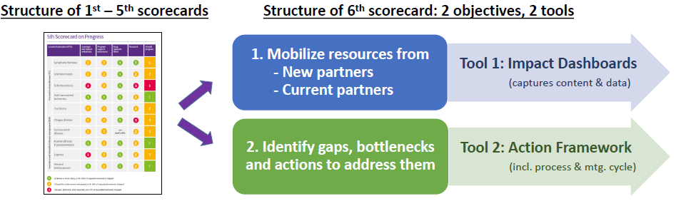
NTD Scorecard Update
Scorecard reviewed in 2017 – two distinct objectives identified and lead to suggestions on new format and content
2018 – Scorecard divided into two annual tools; the Impact Dashboard and Action Framework

Slide 3
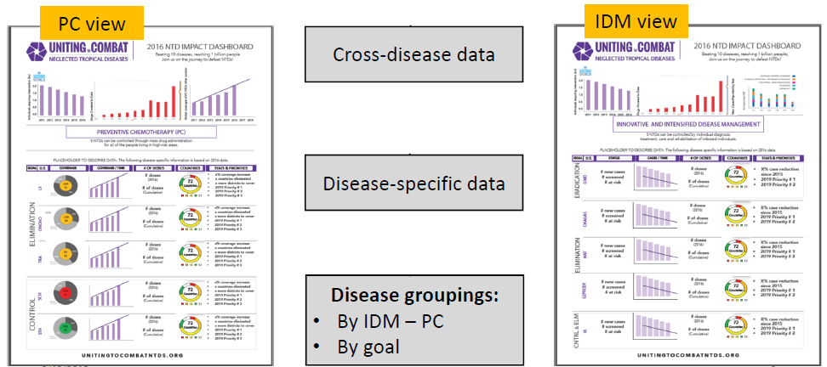
Objective 1: Mobilize resources from new and current partners (Tool: Impact Dashboard)
For current partners with content requested by major donors and stakeholders
Uses WHO quantitative progress indicators
Follows progress across multiple diseases in one view with common measures

Slide 4
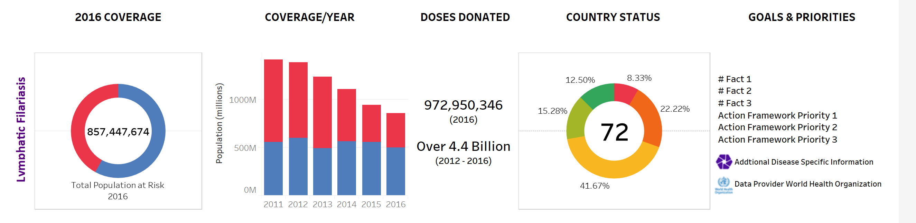
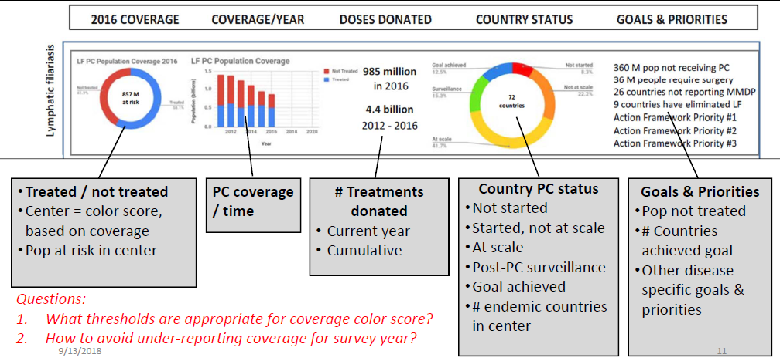
Objective 1: Mobilize resources from new and current partners (Tool: Impact Dashboard)
Example: Draft LF Dashboard using 2016 data
2017 Dashboard and data will be released 28/09/18

Slide 5
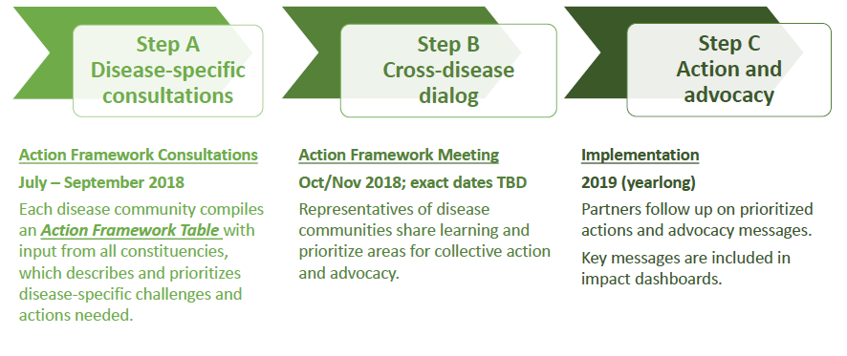
Objective 2: Identify gaps, bottlenecks and actions to be addressed (Tool: Action Framework)
Input provided by constituents directly into the framework regarding the three pillars; Enabling Environment, Strategy, and Public Health Intervention.
  Identify gaps, bottlenecks and collective actions.
  Strengthen NTD partnership through engaging on progress and gaps across 10 diseases
October 10-11, Geneva

Slide 6
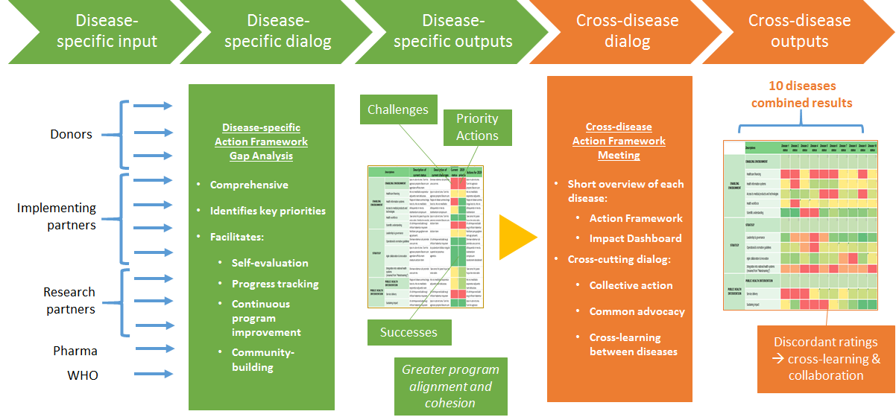
Annual Action Framework process (detail)

Slide 7
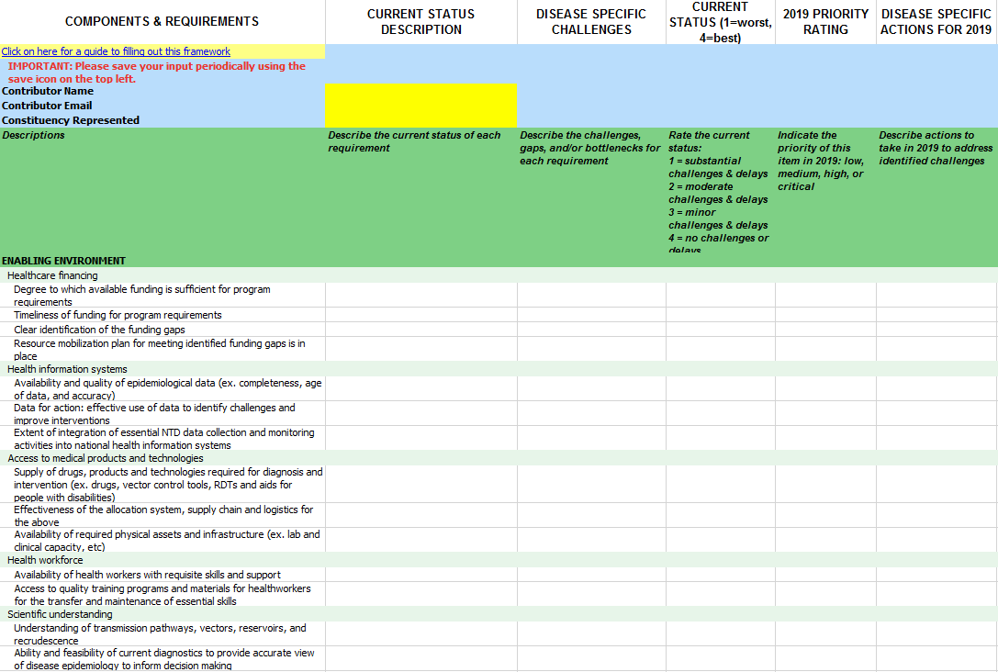
Action Framework – at a glance
Contains 3 pillars and 11 components
32 requirements for comment
Additional sections can be added

Slide 8
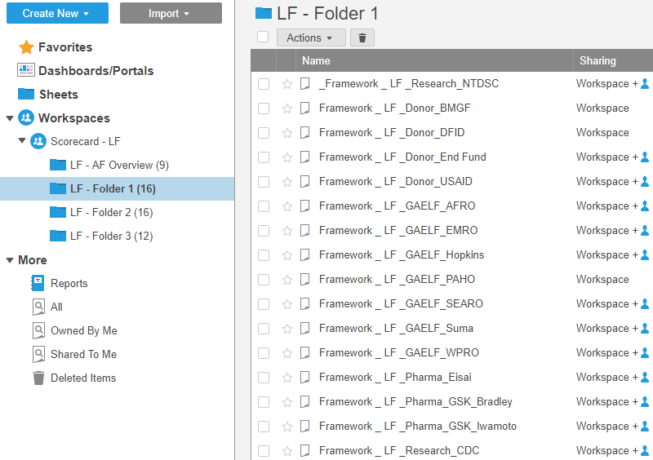
Completing the Framework – Partners Contributions
Action Framework Smartsheet was shared with 48 LF constituents at the end of August (LF NGO Network)
9 have provided feedback which has been entered into the framework
  Enabling environment like healthcare financing
  Health information system
  Access to medical products
  Health workforce
  Scientific understanding
  Operational guidelines
  Service delivery
  Sustaining Impact, amongst others
PARTNER CONTRIBUTIONS ARE CURRENTLY
BEING CONSOLIDATED

Slide 9
Next steps
Further planning and the Evaluation of the Scorecard
Consolidating partner responses to developed overall LF Action Framework.
Action Framework Meeting – October 10th and 11th in Geneva to review and discuss the Action Frameworks for the various diseases, identifying common challenges and cross-disease learning.
  Discussions of post-2020 targets are taking place in early 2019 and the AF meeting outputs could help to inform those discussions

