Slide 1
Mectizan Donation for IDA countries
Yao Sodahlon
Mectizan Donation Program
325 Swanton Way,
Decatur, Georgia 30030, USA
mectizan@Mectizan.org
www.mectizan.org

Slide 2
MSD’s response to the New WHO Guidelines
Merck announced on Nov 2017, it will donate to eligible communities:
  Up to 100 million Mectizan treatments annually through 2025 beginning in 2018.
  Requests will be reviewed and tablets allocated through a transparent and fair mechanism to be established by the Mectizan Donation Program (MDP) and its Mectizan Expert Committee (MEC).
  The approved tablets will be shipped and delivered to the specified warehouse in the recipient countries free of charge.
http://investors.merck.com/news/press-release-details/2017/Merck-Commemorates-30-Years-of-MECTIZAN-Donation-Program-Progress/default.aspx

Slide 3
Mectizan Donation guide for IDA
Developed in November 2017 with stakeholders
Available on MDP websites
Shared with all WHO regional offices
https://mectizan.org/news-resources/mec-guide-for-donations-of-mectizan-in-ida-countries/#

Slide 4
Country eligibility to receive Mectizan for IDA
Epidemiological eligibility
  Non co-endemic for onchocerciasis with:
    IUs that have not started or have fewer than 4 effective rounds of DEC and Albendazole;
    IUs that have not met the appropriate epidemiological targets in sentinel and spot-check site surveys or in transmission assessment survey (TAS) despite meeting drug coverage targets;
    communities where post-MDA or post-validation surveillance identified infection suggesting local transmission.

Slide 5
Country eligibility to receive Mectizan for IDA
  Political commitment
  revised elimination strategic plan with a redefined new elimination target and adoption of IDA as a strategy to accelerate the elimination of LF
  If required, register the donated medicine with the relevant national regulatory authorities
  ensure free entry of Mectizan into the country without imposing duty, tax, or other costs
  One time endorsement of the agreement (Annex 2).
  Ability to plan and implement IDA with high coverage

Slide 6
Mectizan application for IDA and drug allocation and supply
Application forms
  IDA version of the JAP elaborated by WHO (not yet WHO-NTD website )
Application submission
  same as the JAP
  with copy to Mectizan@Mectizan.org along with:
    the revised strategic plan with IDA adopted by the MoH
    the annual plan including districts targeted for IDA and the strategy to implement IDA with high coverage and post intervention M&E
    evidence of eligibility for IDA for each district
    Signed agreement to receive Mectizan under conditions described in annex 2
*www.who.int/neglected_diseases/preventive_chemotherapy/reporting/en/

Slide 7
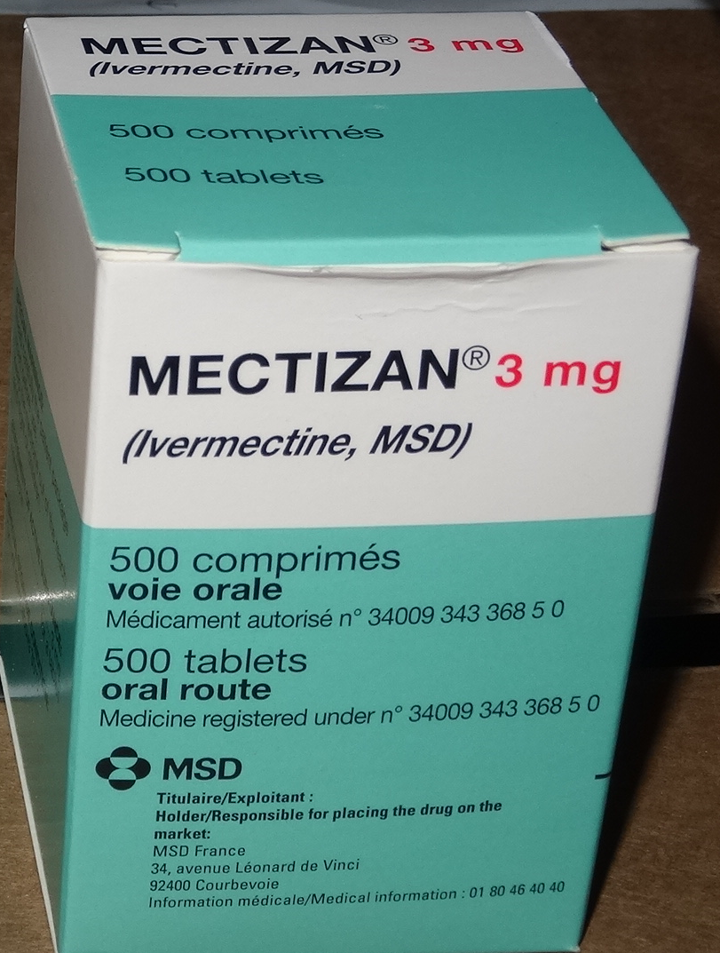
Mectizan application for IDA and drug allocation and supply
Application approval and shipment process
  Applicants will be notified of the decision in writing
    If approved, an approval notice will be sent to the applicant with cc to partners
    The approval notice triggers the shipment process
  Medicines shipped from France
    An international forwarder (Walker International Transportation, Netherlands) will contract a local clearing agent to assist with the local arrangement including the tax exemption paperwork
    By air
    Delivered to the designated warehouse free of charge (incoterm: DDP)

Slide 8
2018 donations for IDA
WPRO: 5 countries (already shipped)
SEARO: 1 country (application in process)
AFRO: 1 country (already shipped)
EMRO: 1 country (under shipment)

