Slide 1
RTI International
Daniel A. Cohn
Sr Technical Advisor
LF NGDO Network Meeting
Addis Ababa, Ethiopia, 26 September 2018

Slide 2
Mission statement
RTI International: to improve the human condition by turning knowledge into practice.
ENVISION Goal: Contribute to the global goal of reducing the burden of targeted NTDs so that they are no longer a public health problem
Also involved in:
  USAID MMDP Project, managed by HKI (implemented by RTI in Ethiopia)
  END Fund-supported MDA for LF and other NTDs (Senegal)
Notes:
MMDP Project in Ethiopia:
Hydrocele surgery and lymphedema case management in Beneshangul, Gambella, Oromia, and Tigray
Burden assessments conducted in all LF-endemic woredas in project-supported woredas in these regions
END Fund funding is from The Reaching the Last Mile Fund

Slide 3
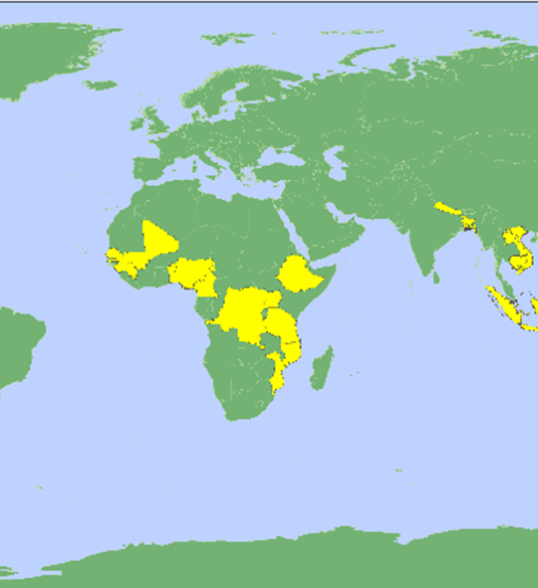
Work in 19+ countries
Bangladesh Nigeria
Benin Philippines
Cambodia Senegal
Cameroon Tanzania
DRC Uganda
Ethiopia Vietnam
Guinea
Haiti
Indonesia
Laos
Mali
Mozambique
Nepal
Nigeria

Slide 4
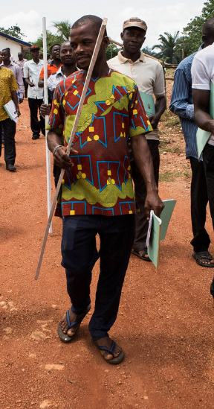
ENVISION Global and Implementing Partners
Led by RTI International
CBM International
The Carter Center
Fred Hollows Foundation
Helen Keller International
IMA World Health
Light for the World
Sightsavers
World Vision
USAID
Ministries of Health
WHO
Other Stakeholders
Notes:
ENVISION is an eight-year award that runs through Sept 2019
USAID has selected RTI for the five-year Control & Elimination of Neglected Tropical Diseases – Element Two (CEP-NTD) Project
Partners (8): The Carter Center, Fred Hollows Foundation, IMA World Health, Light for the World, Results for Development (R4D), Save the Children, Sightsavers, and WI-HER
Countries (13): Bangladesh, DRC, Ethiopia, Haiti, Indonesia, Laos, Mozambique, Nepal, Nigeria, Philippines, Tanzania, Uganda, and Vietnam

Slide 5
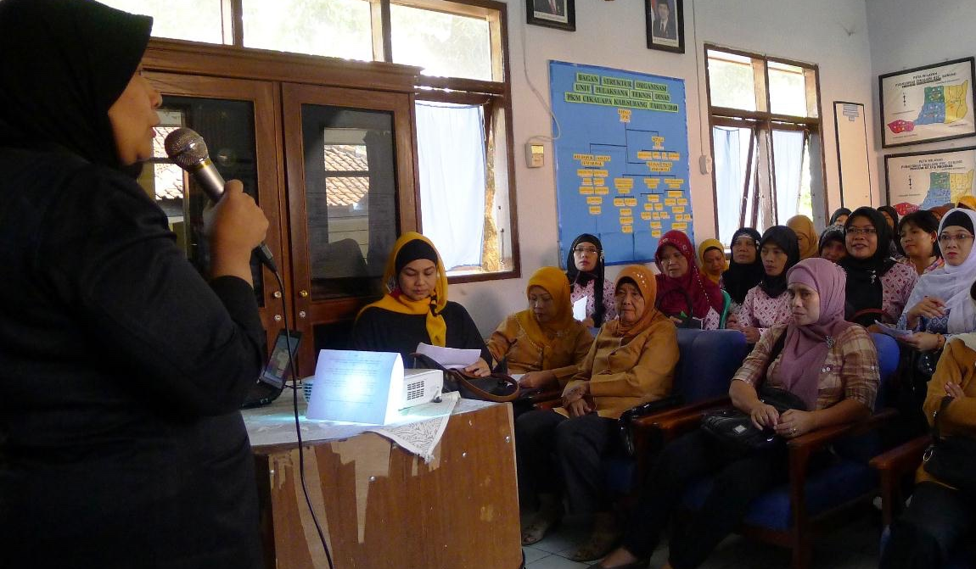
What activities do we support?
NTD policy development
Strategic planning
Advocacy
Drug and diagnostics procurement
Capacity strengthening
Disease mapping
Social mobilization
Mass drug administration (MDA)
Program supervision
Monitoring and evaluation (M&E)
Dossier development
Operational research

Slide 6
Key achievements in last year
88% of ENVISION-supported districts achieved effective epi coverage for LF MDA (FY17)
Piloted standardized electronic data collection for pre-TAS and TAS
Piloted standardized field implementation training module for TAS
Multi-country analysis of Pre-TAS results
Six countries supported to develop dossiers or pre-dossiers
Vietnam submitted LF elimination dossier to WHO
Notes:
Thus far, 95% of ENVISION-supported TAS (TAS1) have “passed” (e.g., met the criteria for stopping MDA), and 96% of the first post-MDA surveillance TAS (TAS2) have passed, with an overall passing rate of 98% to 99% since 2016. In total, 82% of IUs have passed ENVISION-supported pre-TAS.
More than 208 million people in ENVISION-supported countries—or 40% of the total at-risk population—are now living in areas where criteria to stop LF have been achieved.

Slide 7
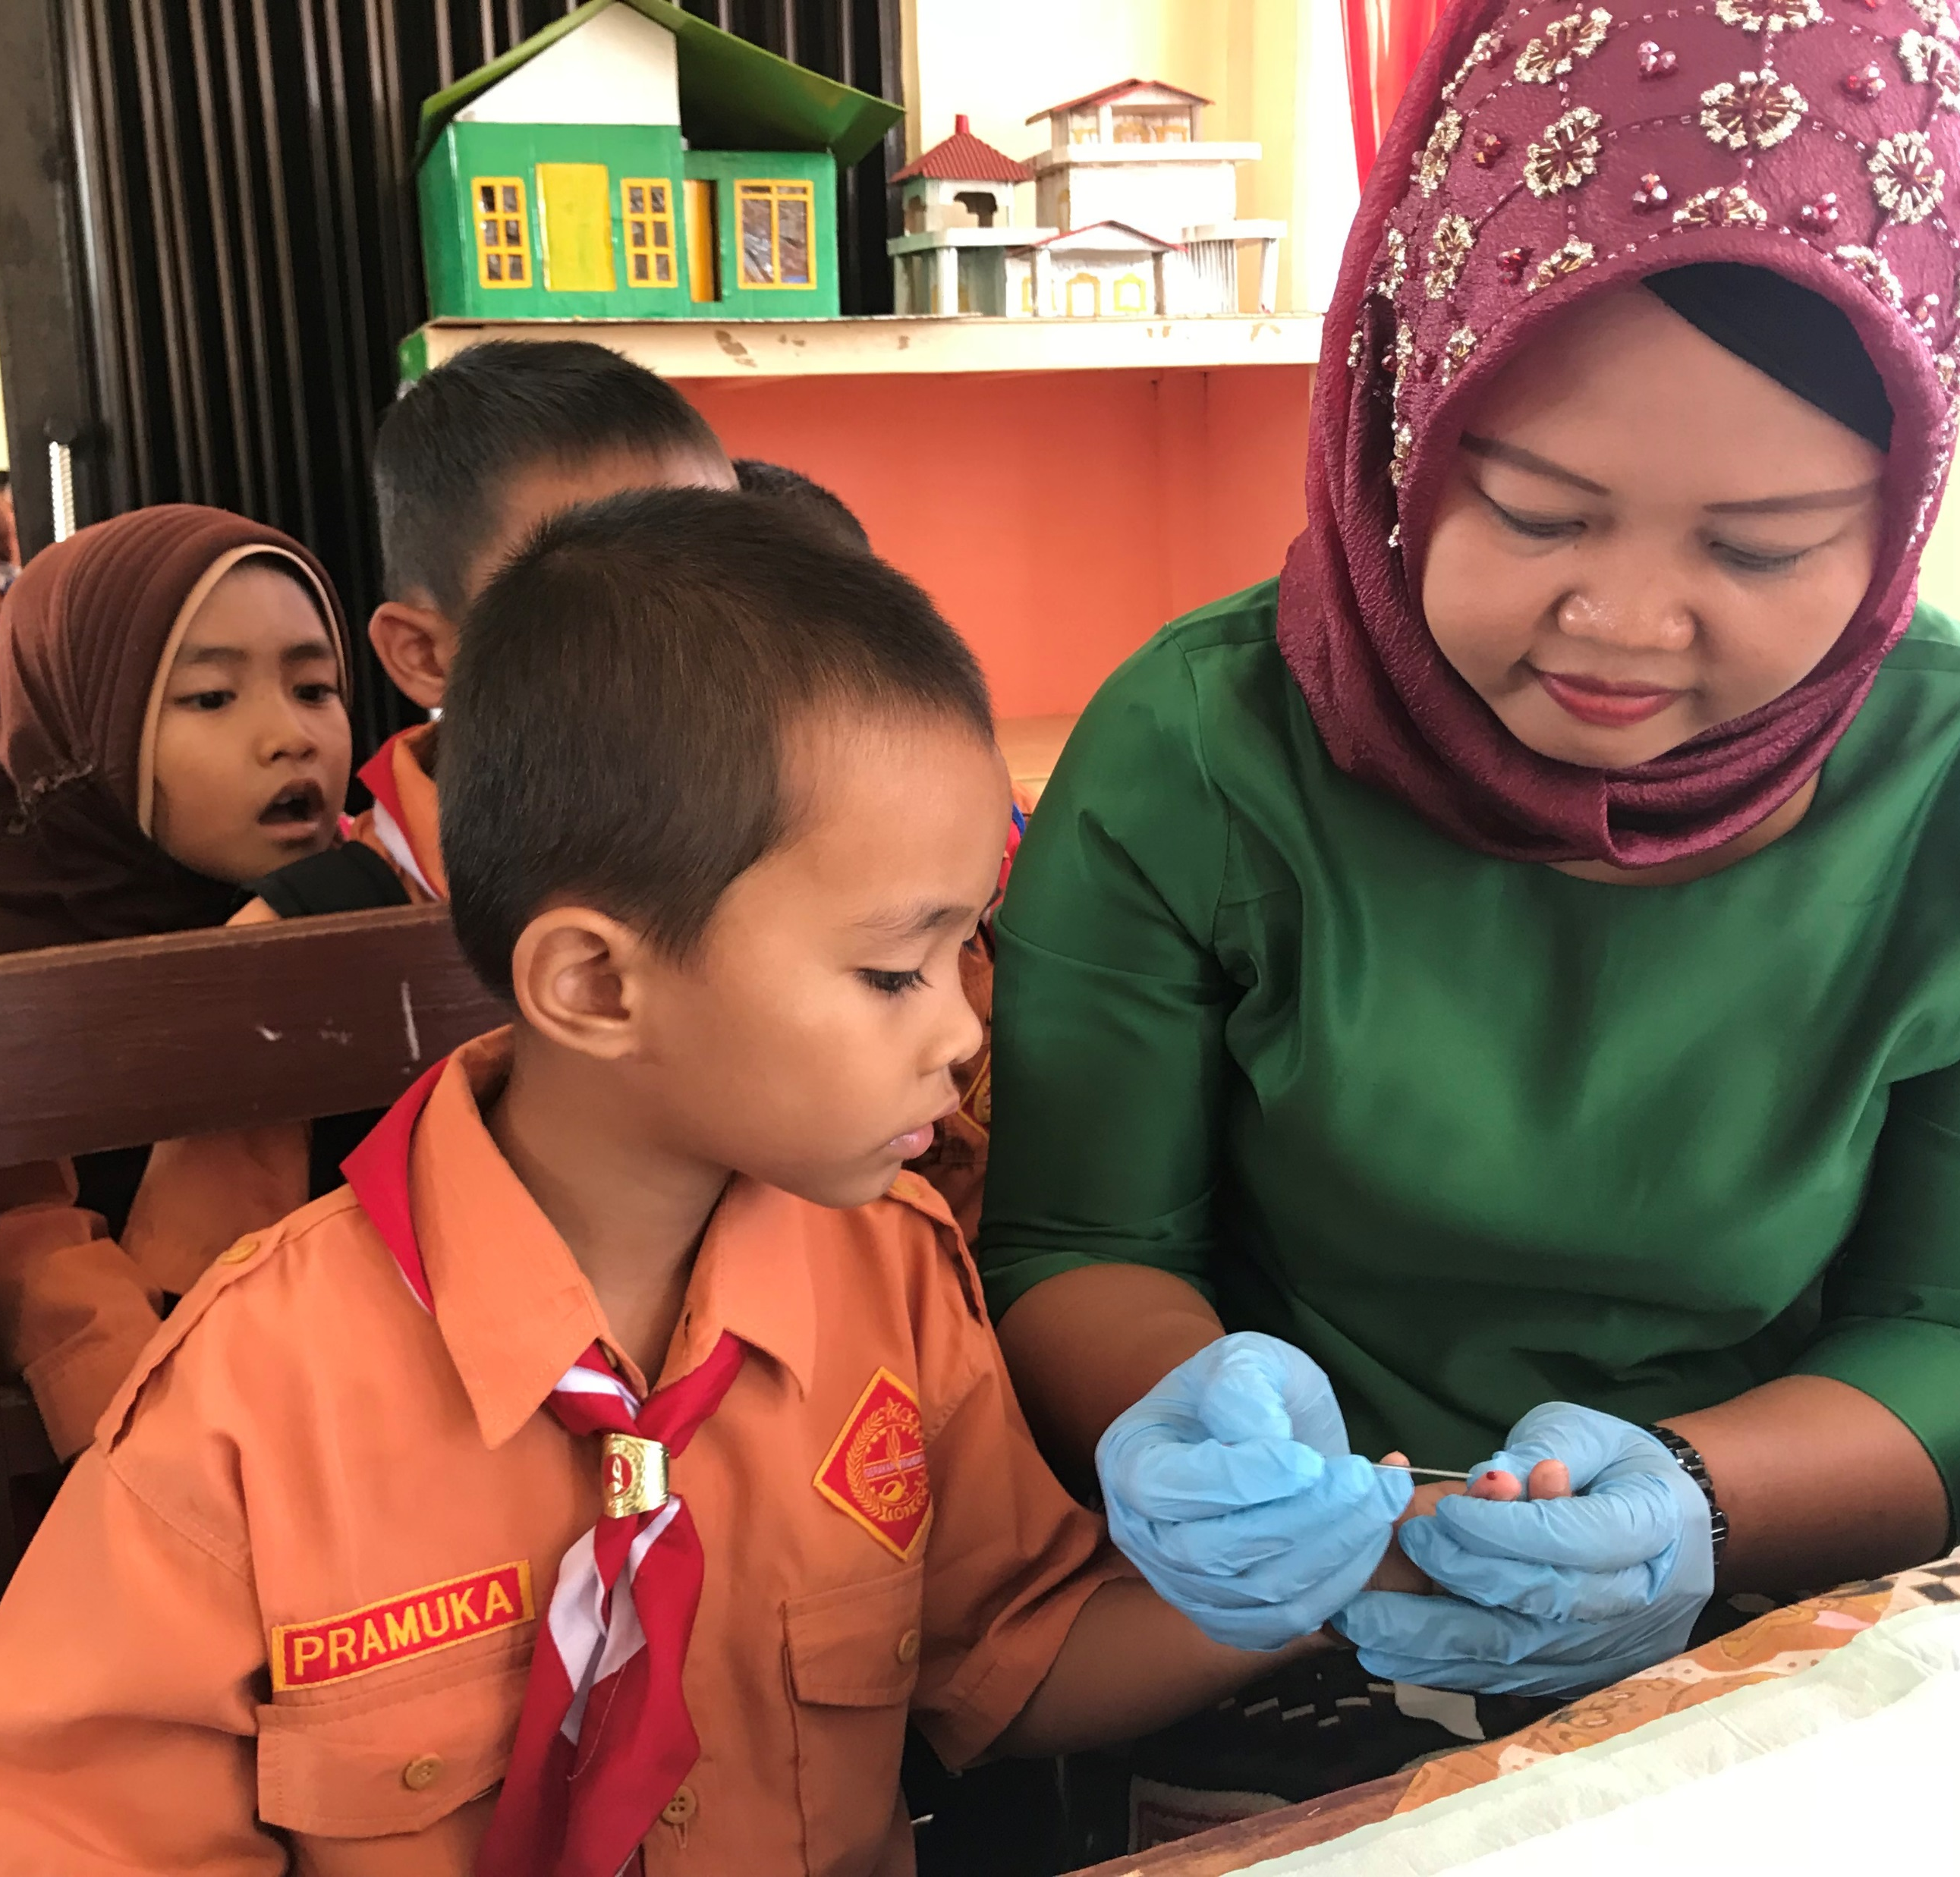
Current issues for next year/immediate future
Ensure quality LF MDA activities
  - Investigate pre-TAS and TAS failures and improve MDA
Implement quality pre-TAS and TAS
Prepare for validation
  Data compiled and in secure databases
  Draft dossiers
  Better understanding of MMDP data and services in supported countries
  Post-validation surveillance guidance
Notes:
In FY19, more than 43.2 million people in 218 districts are targeted for LF MDA with ENVISION support, a decrease from the 56.6 million targeted in FY18.
In FY19, ENVISION plans to support approximately 140 TASs covering 216 implementation units (IUs)
Photo: Indonesia, 2018

