Slide 1
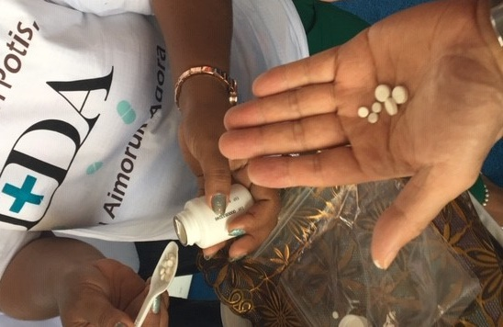
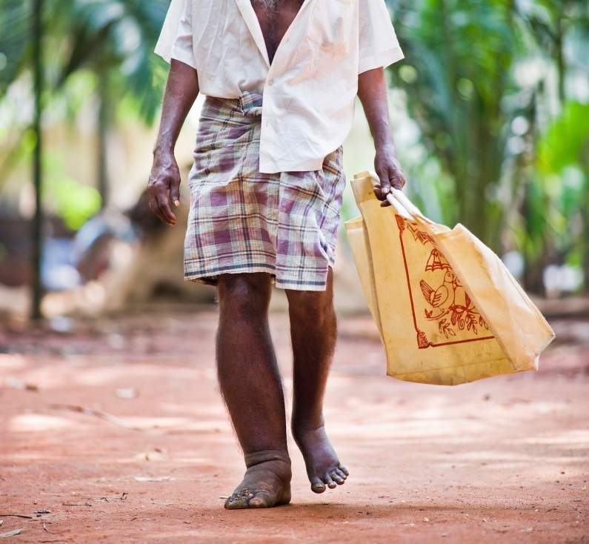
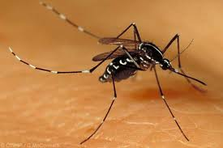
Global Programme to Eliminate Lymphatic Filariasis

Slide 2
Global commitment – WHA 50.29
Elimination of LF as a public health problem
Global Programme to Eliminate Lymphatic Filariasis (GPELF) was launched in 2000
  Interrupt transmission
    Mass drug administration (MDA )
  Reduce suffering and improve quality of life
    Morbidity management and disability prevention (MMDP)
Slide 2

Slide 3
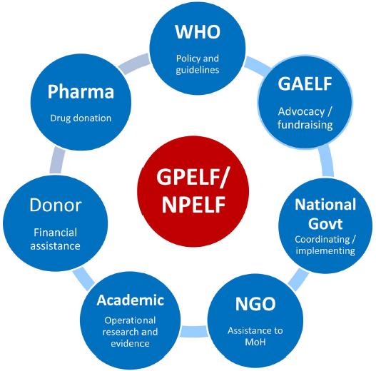
GPELF exists through partnerships
Donor
Finances
Implementation
& research
Academic WHO CC
Research
NPELF – national programmes to eliminate LF
GAELF – Global Alliance to Eliminate Lymphatic Filariasis
Slide 3

Slide 4
The GPELF strategy has led to substantial achievements:
  69 countries implementing MDA, delivering a cumulative total of 7.1 billion treatments reaching more than 890 million people
  52 countries reducing infection below target thresholds and no longer requiring MDA in at least 1 district
  22 countries no longer requiring MDA nationally
  15 countries having achieved the validation criteria for elimination of LF as a public health problem
Slide 4

Slide 5

GPELF Progress: MDA status of countries 2019
MDA not started
MDA started but not at scale
MDA scaled to all endemic districts
Post-MDA Surveillance
Post Validation Surveillance
Equatorial Guinea
Gabon
New Caledonia
Angola
Central African Republic
Congo
Democratic Republic Congo
Guinea-Bissau
Nigeria
South Sudan
Sudan
Madagascar
Guyana
Papua New Guinea
Benin, Burkina Faso
Chad, Cameroon, Côte d’Ivoire, Ethiopia, Ghana, Guinea, Liberia, Mali, Mozambique, Niger, Senegal, Sierra-Leone Tanzania, Uganda,
Comoros , Kenya, Eritrea
Zambia, Zimbabwe
Sao Tome & Principe
Haiti
India, Indonesia
Myanmar
Nepal
Timor-Leste
American Samoa
French Polynesia, Tuvalu
Fiji, FSM, Malaysia, Samoa, Philippines
Malawi
Brazil
Dominican Republic
Bangladesh
Brunei Darussalam
Kiribati
Lao PDR
Egypt
Yemen
Togo
Maldives
Sri Lanka
Thailand
Cambodia
Cook Islands
Marshall Islands
Niue
Tonga
Vanuatu
Palau
Vietnam
Wallis and Futuna
3 (4%)
11 (15%)
36 (50%)
7 (10%)
15 (21%)
Slide 5

Slide 6
New NTD Roadmap targets for 2030
58 countries validated for elimination as a PHP – defined as
-infection sustained below TAS thresholds for at least 4 years after stopping MDA
-availability of minimum package of care in all areas of known patients
72 (100%) countries implementing post-MDA or post-validation surveillance
MDA no longer required
Slide 6

Slide 7
GPELF Priorities 2021-2030 MMDP
Action Required | Milestones & Indicators
Prioritize MMDP within primary health care as part of UHC | 100% (72) countries included LF interventions in UHC essential package by 2025
Countries monitoring LF morbidity and available care by IU | 100% (72) countries reporting to WHO at least partial data by 2023 and complete data by 2025
Countries have data on quality of the provision of care | 100% (72) countries have met dossier requirements to report on quality and readiness by 2030
Slide 7

Slide 8
Other critical actions needed - MMDP
Improve capacity for MMDP within primary healthcare
Ensure accessible and inclusive care for patients to reduce stigma and improve mental wellbeing are part of UHC essential packages
Ensure availability of functional facilities for MMDP in the primary healthcare system, including materials for lymphedema management, hydrocele surgery and medicines to treat acute attacks
Create link with Global Surgery Initiatives to ensure availability of surgery in IUs with known hydrocele burden, and with Social services, rehabilitation and mental health to build capacity for assessment and referral for psychosocial support
Slide 8

Slide 9
GPELF Priorities 2021-2030 - MDA
Action Required | Milestones & Indicators
Map uncertain areas | Need for MDA in all uncertain districts defined by 2021
Implement IDA where warranted | 100% geographical coverage globally with WHO recommended MDA regimen by 2021
Revitalize MDA to achieve high compliance: -build capacity in social mobilization, microplanning, and supervision | Every year, all IU’s target 100% of eligible population in each round
Build capacity - emphasis on quality pre-TAS and TAS implementation | 100% eligible IUs implement surveys at recommended timing
Facilitate government support, mobilize resources, expand partnerships | Sustainable resources for programme activities and post-validation surveillance
Slide 9

Slide 10
Other critical actions needed - MDA
  Develop strategies to mitigate ‘hot-spots’ of persistent infection and reach missed populations
  Develop new approaches for urban MDA
  Develop diagnostic test which is not cross-reactive with L. loa
  Improve reliability of current diagnostic tests;
  Ensure reporting of issues with diagnostic tests for quality monitoring
Slide 10

Slide 11
Critical actions needed - surveillance
Improved diagnostics for post-MDA surveillance
Encourage sustained commitment post-validation to avoid recrudescence
Specify the minimum standards for post-validation surveillance (PVS) and how to set up and maintain activities
Integrate vector management and surveillance (where feasible) through the Global Vector Control Response to supplement MDA
Define criteria to achieve verification of interruption of LF transmission
Slide 11

Slide 12
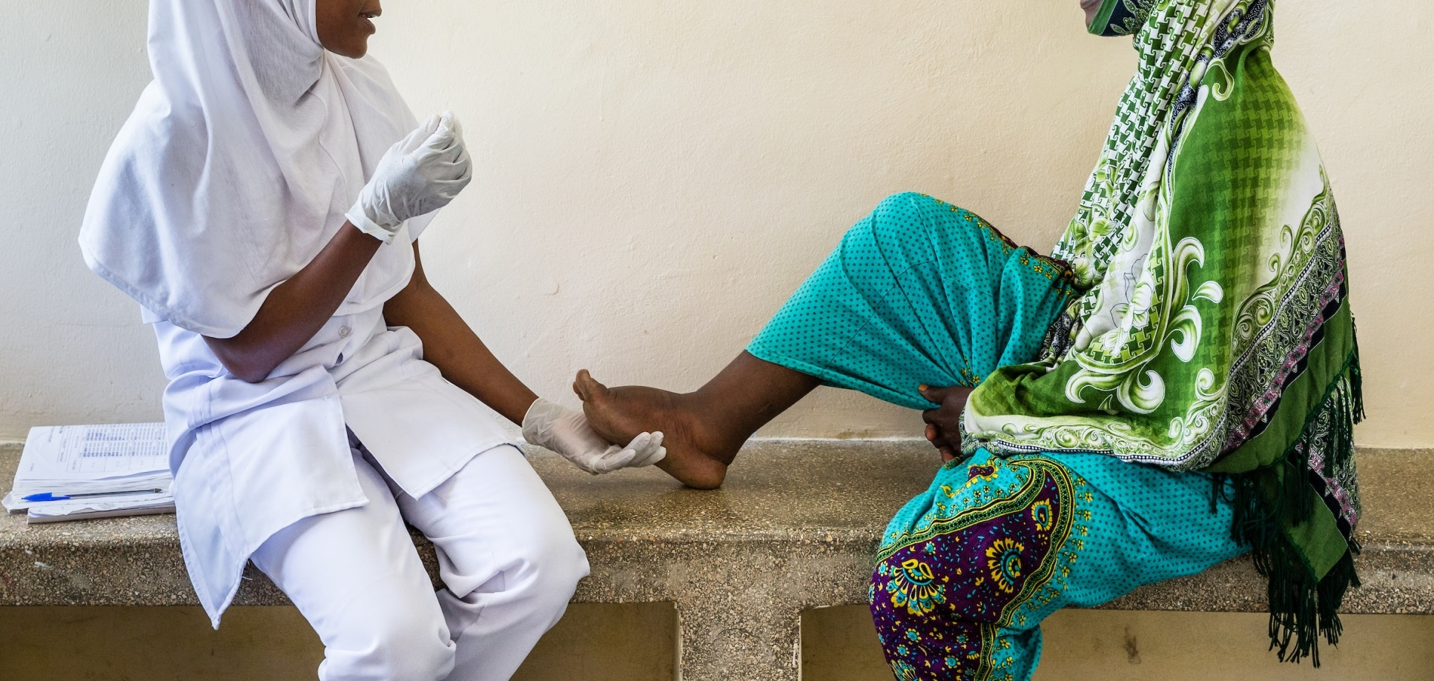
Thank you
Please send questions to: kingj@who.int
courtesy of Zanzibar & GSK

Slide 13
Status of IDA implementation 2019
Assessing need
for IDA
Considering IDA
Planning IDA
Started IDA
Comoros
Zambia
Zimbabwe
French Polynesia
FSM
Haiti
Nepal
Myanmar
Philippines
Eritrea
Madagascar
Guyana
Indonesia
New Caledonia
Tuvalu
Kenya
Sao Tome & Principe
Egypt
India
Timor Leste
Malaysia
American Samoa
Samoa
Papua New Guinea
Fiji
5
4
6
10
Slide 13

