Slide 1
The MENTOR Initiative
Angola LF interventions overview
NNN conference
September 2019
REDUCING DEATHS AND SUFFERING
FROM TROPICAL DISEASES

Slide 2
MENTOR in Angola
Present since 2003
NTD control program since 2012
Started focused in SCH and STH control in 3 provinces
Scaled up to 7 provinces and integrated ONCHO and LF in 2 provinces
Currently supporting 2 districts in Uige Province through annual CBDW campaigns
Support at central level

Slide 3
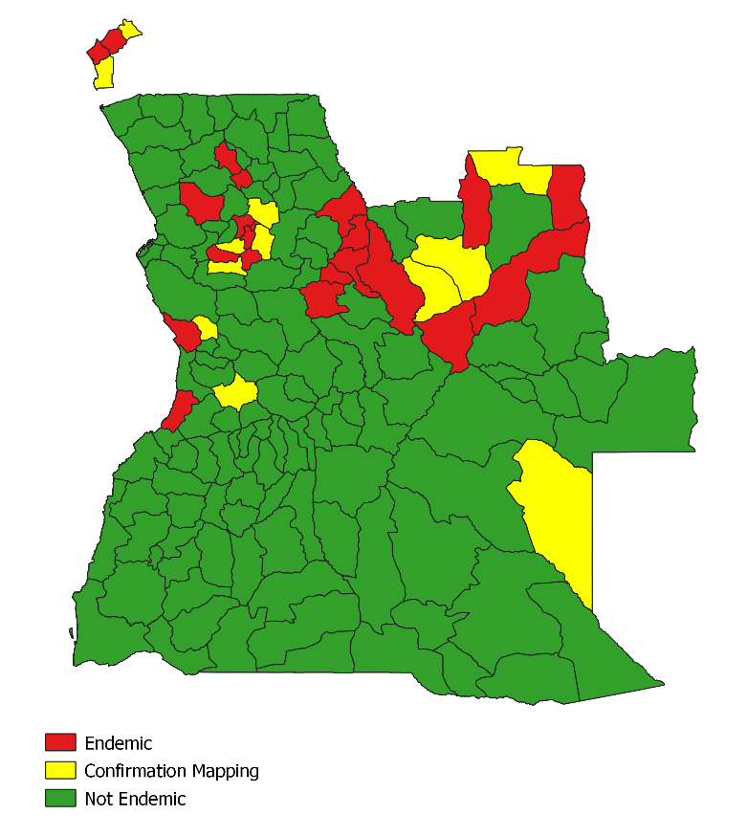
LF in Angola
Mapping conducted in 2017 (FTS and DBS)
Slides still being read
Endemic in 22 districts out of 164
Requires mapping confirmation in 12 districts
MENTOR supporting CBDW in 2 districts in Uige

Slide 4
Challenges and opportunities
New mapping data “available”
Remapping required in 12 districts
Most endemic districts are not targeted for LF (or any other NTD)
Experience from Uige: Hard to achieve desired coverage in CBDW campaigns: what is the best model?!

Slide 5
Thank you

