Slide 1



Liverpool, September 2019
M Baker
LF NGO Working Group Meeting, NNN

Slide 2

Support countries to eliminate and/or control NTDs with proven, cost-effective public health interventions
Program Goal
2
Notes:
Focus on elimination of LF and trachoma. A new emphasis on mainstreaming NTDs and strengthening systems for sustainability

Slide 3
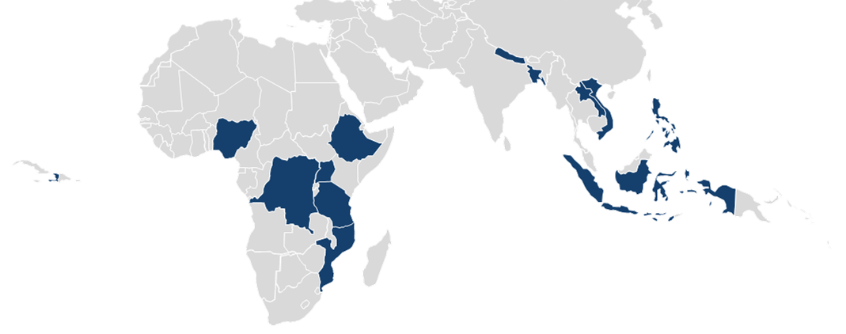
Act to End NTDs | East Program Overview:
Period of Performance: September 17, 2018 – September 16, 2023
Total estimated Federal/USAID: $295,838,220.00
Centrally funded and managed by USAID Washington DC
One year overlap with ENVISION in FY19
13 countries globally:
  Africa: DRC, Ethiopia, Mozambique, Nigeria, Tanzania, Uganda
  Asia: Bangladesh, Indonesia, Laos, Nepal, Philippines, Vietnam
  Latin America and the Caribbean: Haiti
Notes:
LF support in everywhere except DRC and Mozambique

Slide 4

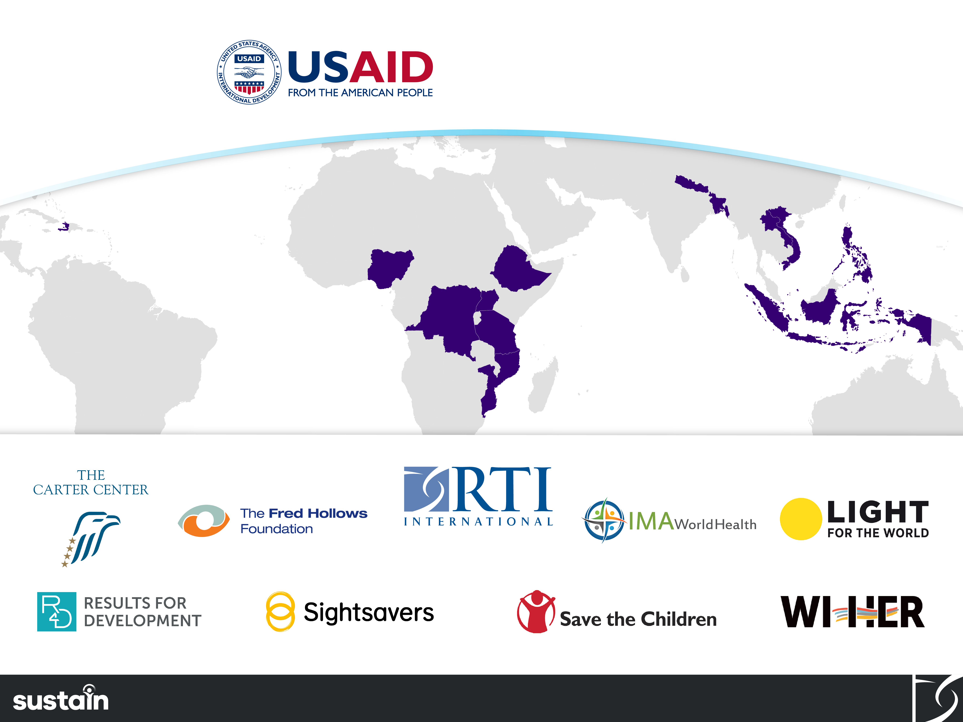
Our Consortium Partners

Slide 5
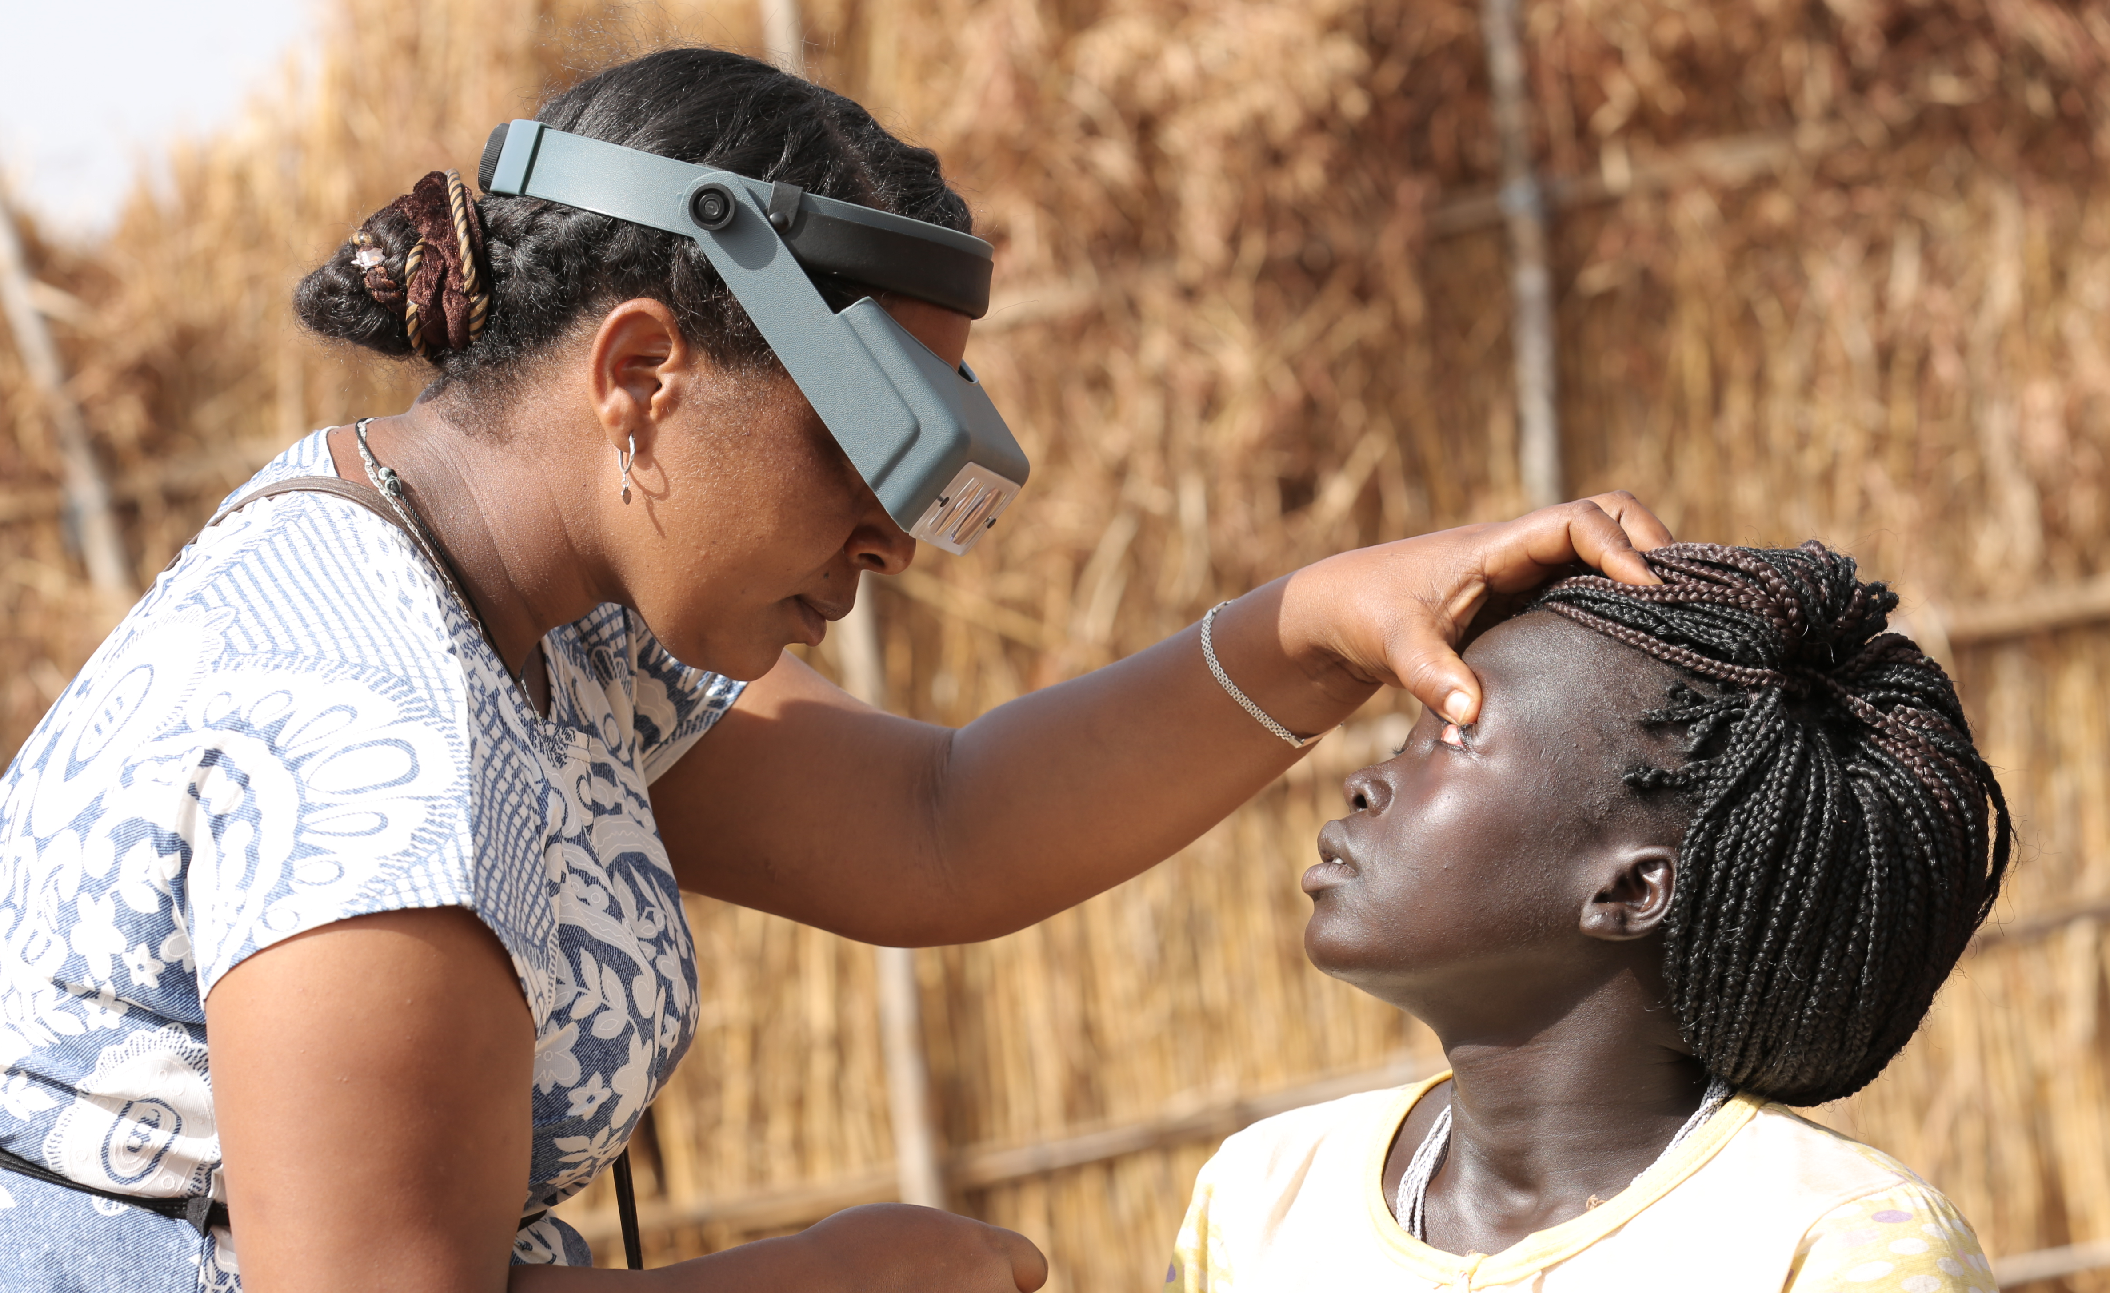
Program Goals:
1 - Elimination of LF and trachoma, and of onchocerciasis where feasible
2 – Mainstreamed NTDs and strengthened systems for sustainability
3 – Control of SCH and STH

Slide 6

Technical Focus - Supporting National Governments & Global Policy
Quality MDA
Quality surveys
Survey failure investigation
Dossier development
Building capacity
Influence policy
Collaborate with operational researchers
No direct MMDP, vector control support

Slide 7
LF key achievements in last year
Key data points:
49 million people treated (ENVISION FY18)
290 districts conducted surveys (ENVISION FY18)
Stopped MDA in 29% of endemic districts, with 40% of pop no longer at risk (Act | East FY19)
Technical briefs:
Response to pre-TAS/TAS failure
Dossier development
Real-time data use during MDA
Tools:
Compiling data on pre-TAS/TAS failure
Notes:
290 districts = either pre-TAS, TAS1, TAS2 or TAS3. Could be repeats between pre-TAS and TAS1.

Slide 8
Going forward
At country level:
Continue to support LF MDA
  Planning for future IDA (Indonesia)
  Improving MDA in areas with persistent transmission
Strengthening EDC 'Tropical data-like system’ support for Pre-TAS and TAS
    Protocol and report development and review
    EDC data monitoring
    Continuing to report on invalids
Work with national programs and partners for elimination and sustainability
  Data compilation and storage
  Drafting dossiers
  Analyzing what is needed for sustainability of MMDP and surveillance
At global level:
Working with WHO and partners on PVS guidance development
Aiding WHO in finalizing MMDP Toolkit tools, e.g. situation analysis and DIP
Notes:
DIP = direct inspection protocol; health facility assessment of lymphedema services as part of third MMDP requirement for dossier
IDA == potentially in Nepal, Haiti and Philippines depending on what national programs decide and need

Slide 9
ACKNOWLEDGMENTS
This presentation is made possible by the generous support of the American People through the United States Agency for International Development (USAID). The contents are the responsibility of Act to End NTDs | East, led by RTI International in partnership with The Carter Center, Fred Hollows Foundation, IMA World Health, Light for the World, Sightsavers, Results for Development, Save the Children, and WI-HER under cooperative agreement No. 7200AA18CA00040 and do not necessarily reflect the views of USAID or the United States Government.

