Slide 1
Act to End Neglected Tropical Diseases | West Program
LF NGDO Network, NNN Annual Meeting 2019, Liverpool
Ernest Mensah | September 18, 2019

Slide 2
Act to End NTDs | West Program
USAID Funded
Period of Performance: July 2018 – July 2023
Managed by FHI 360-led consortium

Slide 3
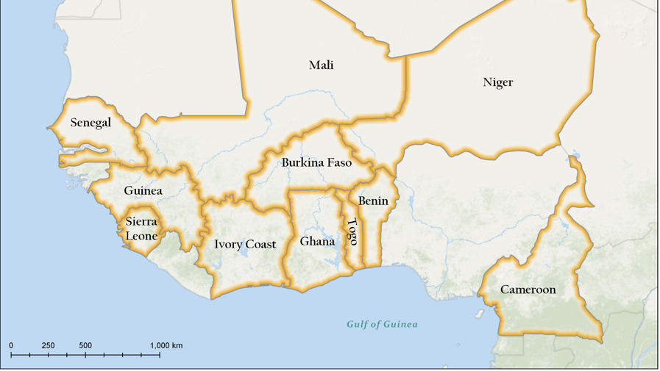
Countries and diseases
. LF
. Oncho
. Trachoma
. SCH
. STH

Slide 4
Act |West: Result Framework
Intermediate result 1
IR/SUSTAINABILITY
Increased MDA coverage among at-risk populations in endemic countries
70% program
Strengthen country environment for implementation and management of NTDPs
Sustained MDA coverage among at-risk populations in endemic countries
Expected Outcomes from sustainability in the following priority areas:
NTDs core functions included into national health system policies NTDP mobilized domestic funding to support program needs NTDP has, at minimum, funding for deworming program NTDs health workforce needs met NTDs indicators are mainstreamed into HMIS Deworming institutionalized in selected countries and long-term delivery platforms used

Slide 5
Act to End NTDs | West consortium

Slide 6
LF Activities Supported
Support across the preventive chemotherapy spectrum
Mapping
MDA
Diseases specific assessments
Building country capacity
Morbidity management – integrated health system focus
Situational analysis
MMDP Strategic plan
Burden estimates
Logistics for MMDP – medicines and disposables

Slide 7
LF Activities Supported
FY19:
Stopped MDA in 457/691 districts (66%)
MDA targeted – 167 districts
Pre-TAS/TAS targeted – 169
MMDP Situational Analysis
FY20:
MDA target, 166 districts
pre-TAS/ TAS in 183 districts
MMDP Situational Analysis and strategic plan development

Slide 8
Thank you

