Slide 1
Morbidity Management and Disability Prevention (MMDP) Project
Tools and Resources – Lymphatic Filariasis
LF NGO Network
Liverpool, England
16 September 2019

Slide 2
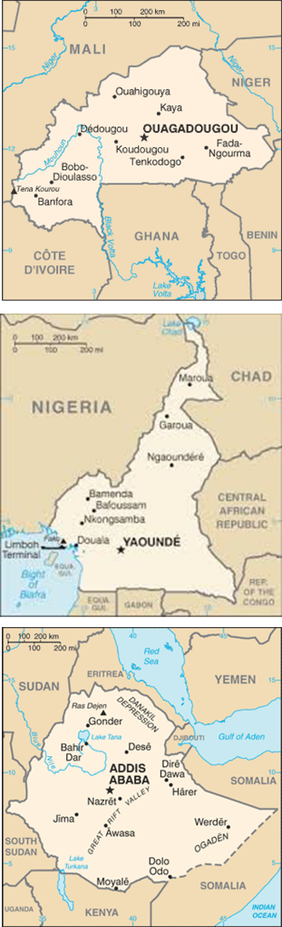
MMDP Project (FY15 – FY19)
The USAID-funded MMDP Project supports high quality trachomatous trichiasis (TT) and lymphatic filariasis (LF) interventions using preferred practices and develops new and innovative strategies when needed to meet TT and LF elimination goals.
Works with ministries of health and other in-country partners to strengthen the capacity of MMDP systems and scale up MMDP implementation with data driven decision-making.
Develops tools and resources to support the provision of high-quality TT and LF MMDP services.
Supports WHO’s global program and works in partnership with the NTD community to share knowledge and meet shared goals.

Slide 3
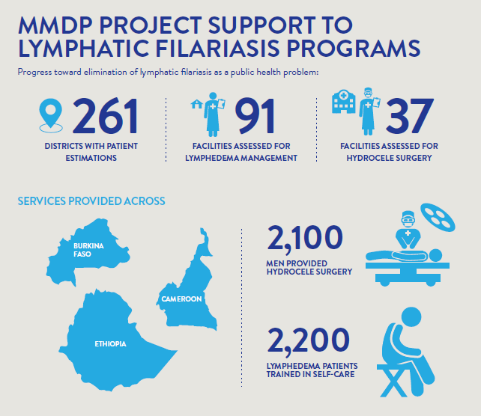
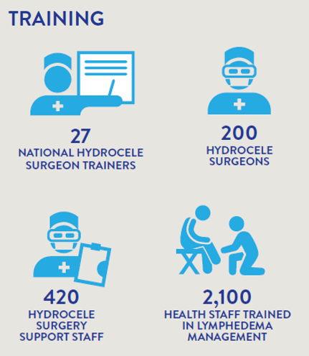

Slide 4
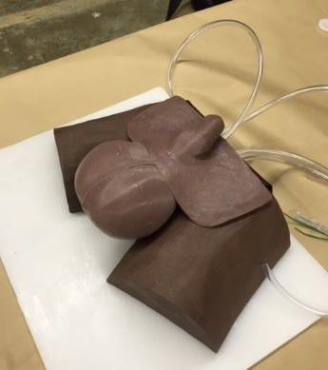
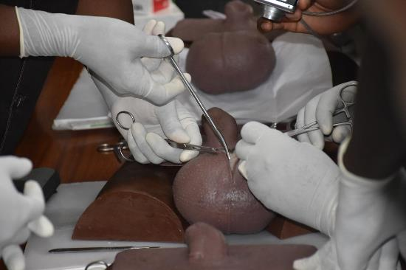
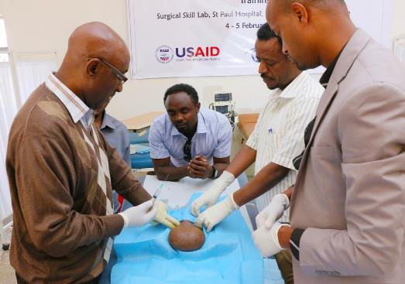
Filaricele Anatomical Surgical Task Trainer
The FASTT simulator features the resection technique and focuses on the key surgical skills of incision-making, blunt dissection, and suturing, three of the important components of hydrocele surgery.
The size of the hydroceles that the simulator represents is Stages II-III (according to Capuano’s classification).

Slide 5
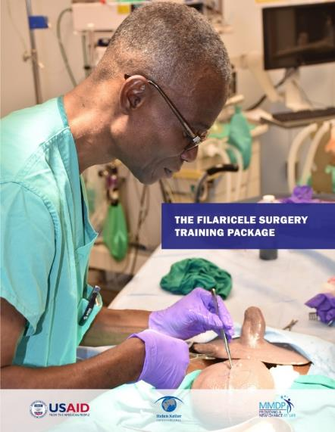
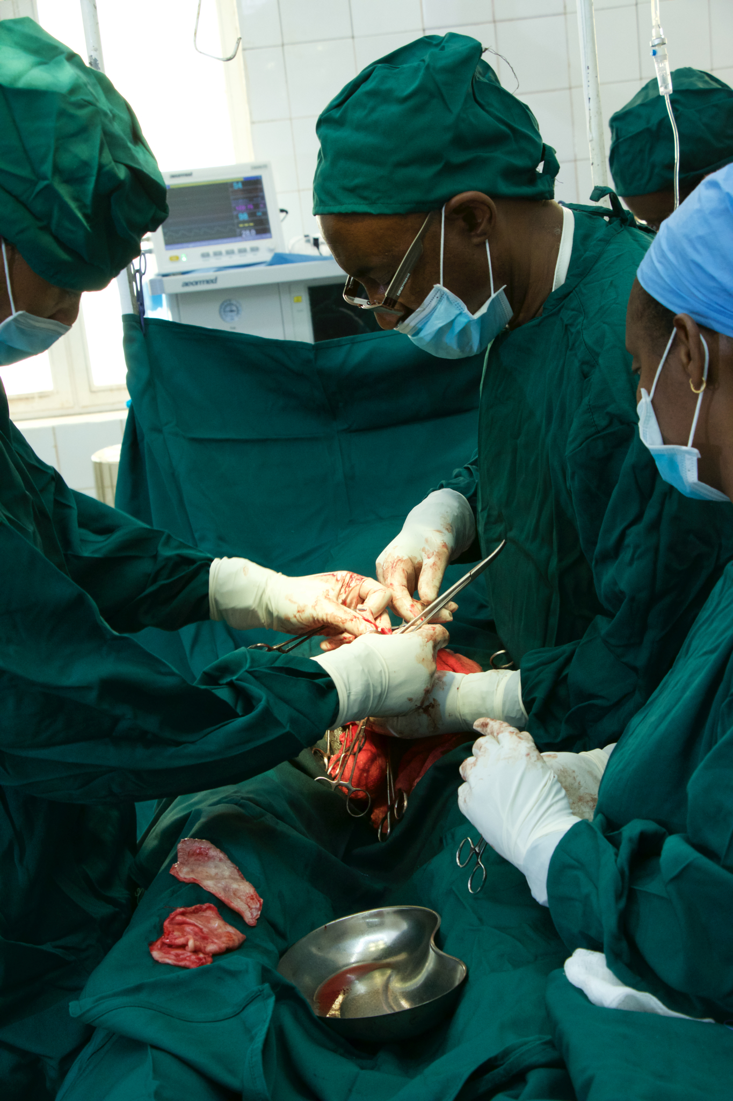
Filaricele Surgery Training Package
This training package provides instructional materials to assist countries to train filaricele surgeons.
The package includes videos, a training guide, PowerPoint presentations, and a surgical handbook.
The package also includes optional modules on usage of the FASTT surgical simulator.
Filaricele Surgery Training Package
Notes:
It might be confusing to have the same cover on this resource and on the FASTT Manufacturing Manual. I asked Sunny if I could use his photo for the manual and he agreed. Is there another photo you could use for the training package? Doesn’t need to be changed right away but before things are final.

Slide 6


Procurement Calculator for Hydrocele Surgery
This calculator quantifies the amounts of needed drugs, disposable materials, and durable goods for high-quality hydrocele surgery.
The tool is based on recommendations contained in the World Health Organization's 2019 report from an informal consultation among experts titled Surgical Approaches to the Urogenital Manifestations of Lymphatic Filariasis.
The calculator includes a provision for hernias.

Slide 7
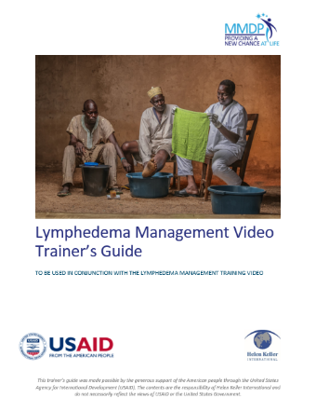

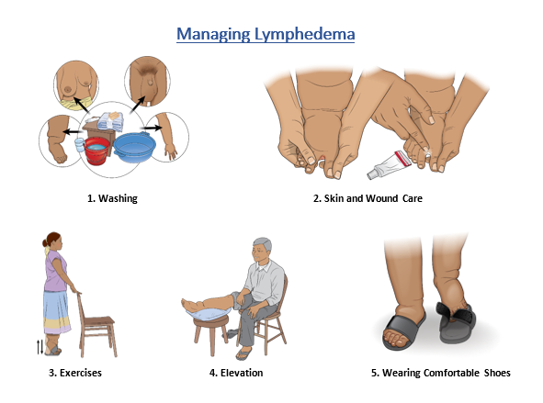
Lymphedema Management Video
and Trainer’s Guide
This video and accompanying guide (with handouts) provides supplementary instructional materials for community health workers and other trainers conducting a training on lymphedema management.
Version Française est en cours

Slide 8
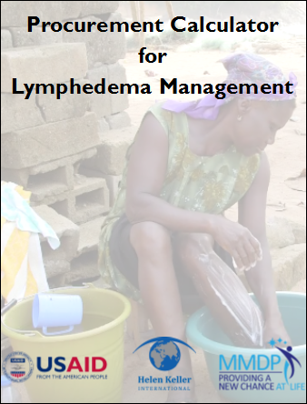
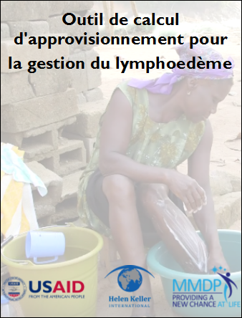
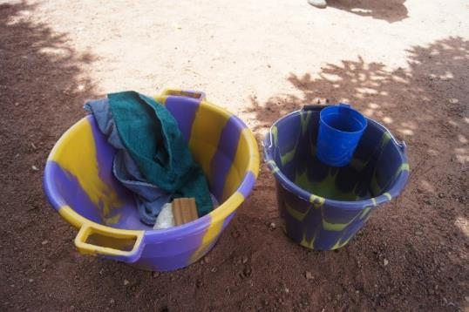
Procurement Calculator for Lymphedema Management
This calculator quantifies the amount of drugs and supplies needed for high-quality lymphedema management, including the treatment for acute attacks.

Slide 9

Translations
Translation of « Surgical Approaches to the Urogenital Manifestations of Lymphatic Filariasis »
French
Spanish
Portuguese

Slide 10
Thank You
Thank You

