Slide 1
Mectizan Donation Program
LF NGDO Network Meeting Liverpool, UK - 18th September 2019
Yao Sodahlon
Director

Slide 2
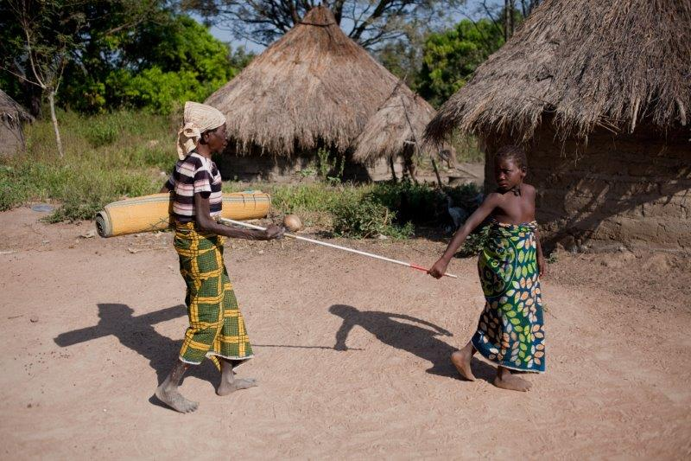
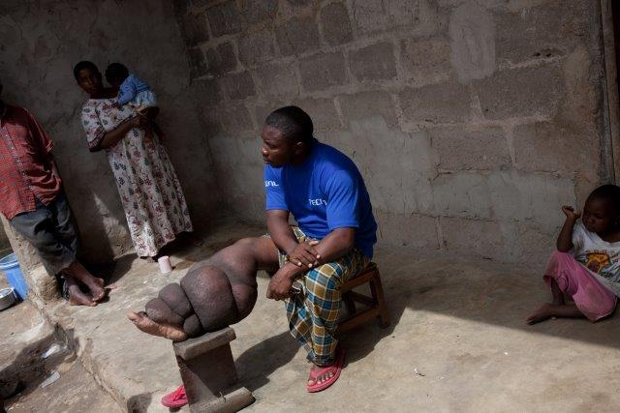
MSD’s commitments:
Facilitate access to ivermectin though the donation of Mectizan®
River blindness
Elephantiasis

Slide 3
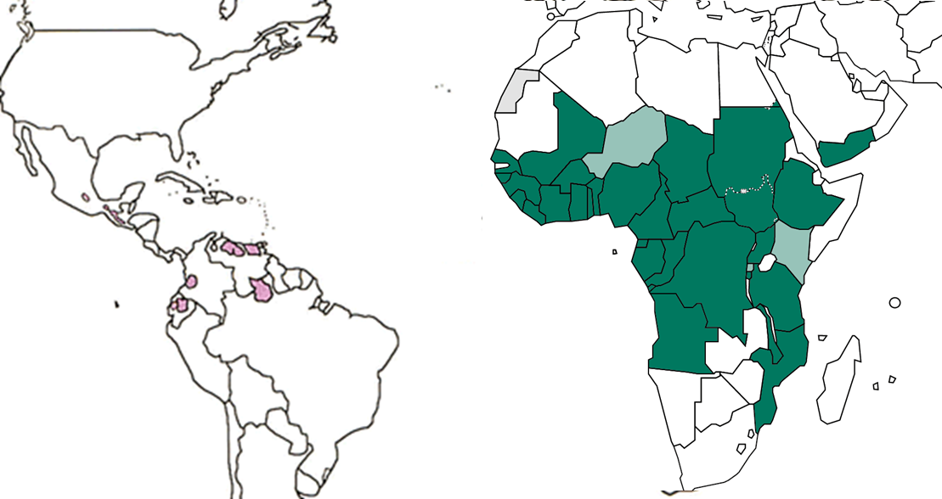
MSD’s commitments
Unlimited for onchocerciasis since 1987: 37 countries (around 198 million beneficiaries)
Unlimited for LF elimination in countries co-endemic with oncho since 1998: 31 African countries and Yemen (around 350 millions beneficiaries)
31 African countries
Angola, Benin, Burkina Faso, Burundi,
Cameroon, Central African Republic, Chad, Congo, Democratic Republic of Congo, Côte d'Ivoire, Ethiopia, Equatorial Guinea, Ghana, Guinea, Guinea Bissau, Gabon, Liberia, (Kenya), Malawi, Mali, Mozambique, Niger, Nigeria, (Rwanda), Senegal, Sierra Leone, Sudan, S. Sudan, Tanzania, Togo
Uganda
Yemen
Yemen
6 Latin American countries
Brazil, Ecuador, Venezuela,
Colombia, Guatemala, Mexico

Slide 4
MSD’s commitments
3. Up to 100 million treatments per year through 2025 to support IDA implementation for the acceleration of LF elimination in countries where onchocerciasis is not co-endemic.

Slide 5
45 countries* eligible for IDA (August 2019)
* in bold
MDA not started | MDA started by not at scale | MDA scaled to all endemic IUs | Post-MDA surveillance | Elimination as a Public Health Problem
Equatorial Guinea Gabon South Sudan New Caledonia | Angola Central African Republic Chad Congo Democratic Republic of Congo Ethiopia Guinea Bissau Nigeria Sudan Comoros Eritrea Madagascar Guyana Indonesia Papua New Guinea | Benin, Burkina Faso, Cameroon, Cote d’Ivoire, Ghana, Guinea, Liberia, Mali, Mozambique, Niger, Senegal, Sierra Leone, Tanzania, Kenya, Zambia, Zimbabwe, Sao Tome & Principe Dominican Republic, Haiti, India, Myanmar, Nepal, Timor-Leste, A. Samoa, French Polynesia, Fiji, FSM, Malaysia, Samoa, Brunei, Darussalam, Philippines, Tuvalu | Malawi Brazil Bangladesh Kiribati Lao PDR | Egypt Yemen Maldives Sri Lanka Thailand Togo Cambodia Cook Islands Marshall Islands Palau, Niue, Tonga Vietnam, Vanuatu, Wallis and Futuna
1/4 IDA | 6/15 IDA | 20/33 IDA | 4/5 IDA | 14/15 IDA

Slide 6
Country eligibility to receive
Mectizan for IDA
Epidemiological eligibility
  Non co-endemic for onchocerciasis with:
    IUs that have not started or have fewer than 4 effective rounds of DEC and Albendazole;
    IUs that have not met the appropriate epidemiological targets in sentinel and spot-check site surveys or in transmission assessment survey (TAS) despite meeting drug coverage targets;
    communities where post-MDA or post-validation surveillance identified infection suggesting local transmission.
  Priority will be given to IUs that meet criteria 2 and 3 (limited donation)

Slide 7
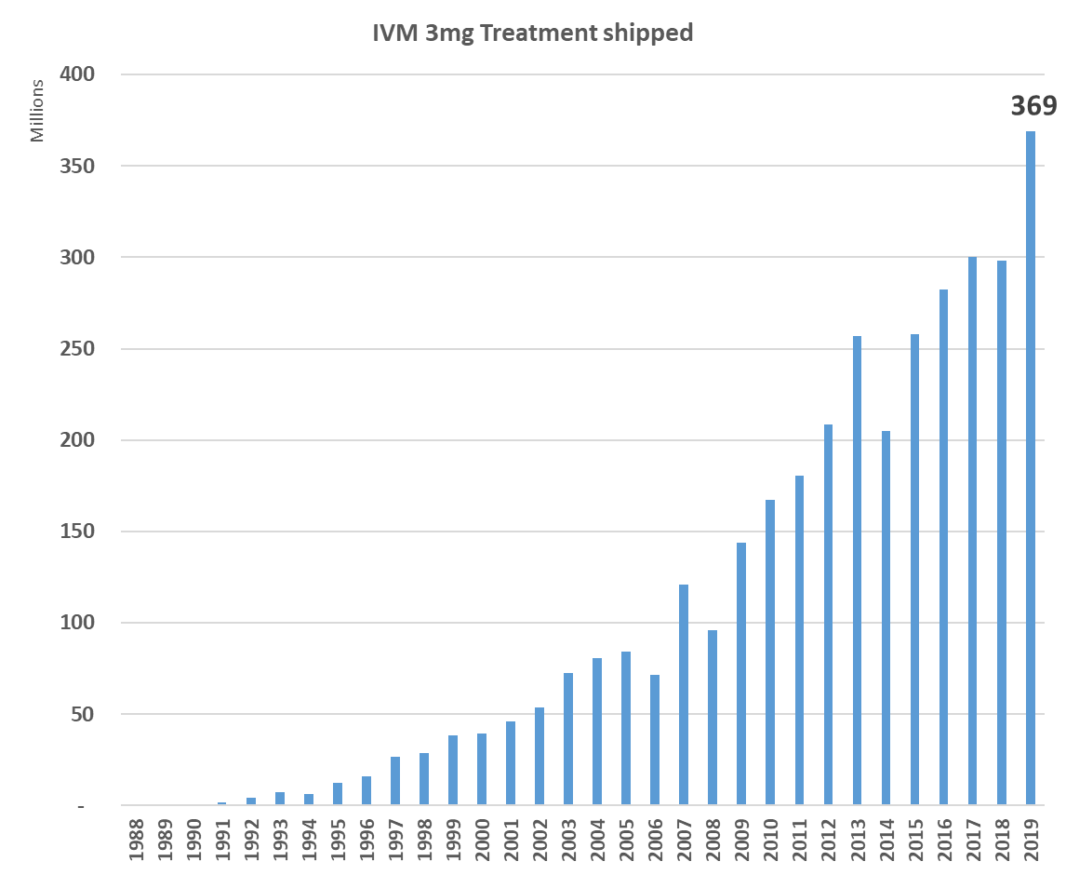
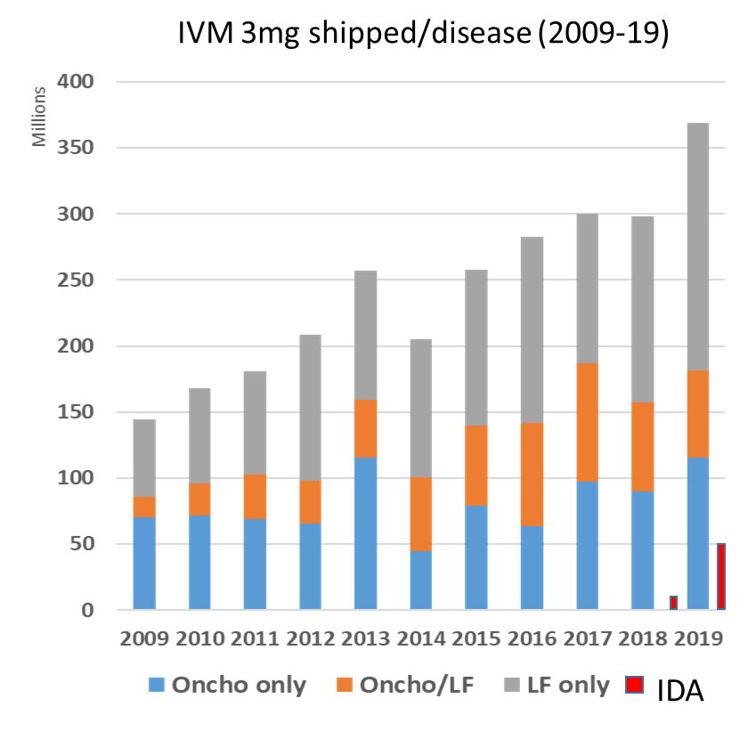
3.5 billion treatments shipped IVM treatments shipped (Dec. 2019

Slide 8
