Slide 1
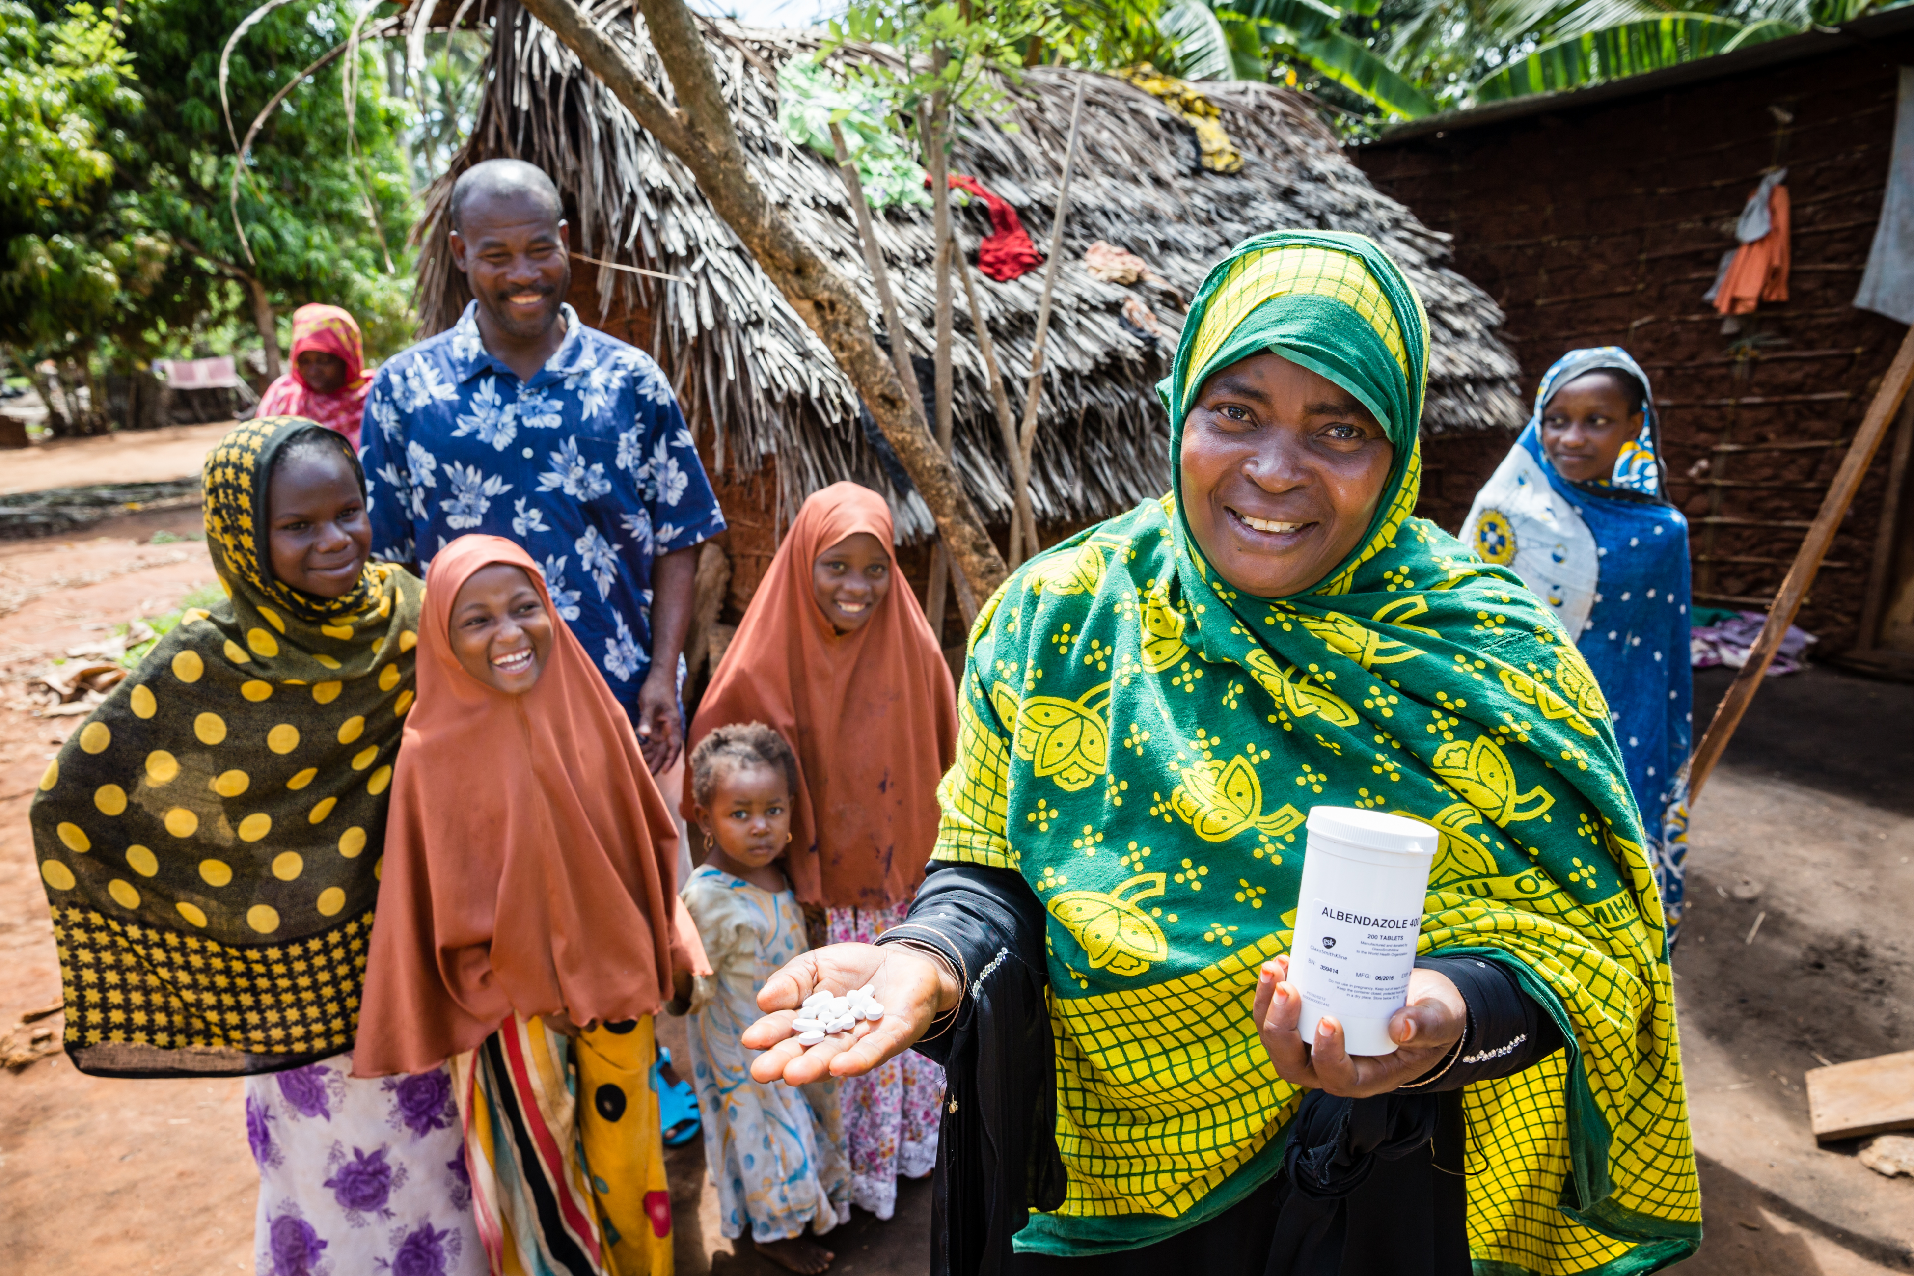
Albendazole Donation Programme Update
Tijana Williams

Slide 2
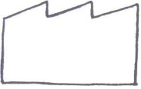
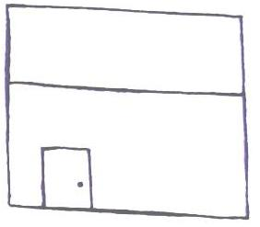

GSK Supply Chain
  Up to 600 million Albendazole tablets each year to WHO until LF is eliminated as a public health problem
  Up to 400 million Albendazole tablets each year to WHO through 2020 for de-worming of school age children
Government Warehouse
India
India Supply
400 Million (m)
Tablets /year
3rd Party API Manufacture
SeQuent, India
Secondary
Manufacture
Nashik, India
Global Supply
Government Warehouses
Global
600 Million (m)
Tablets /year
3rd Party API Manufacture
Uquifa, Mexico
Secondary
Manufacture
Cape Town

Slide 3
Total Number of Tablets Donated/Year for LF & STH (m)

Slide 4
Cumulative Number of Tablets Donated/Year (m)

Slide 5
The LF programme has had substantial achievements:
  Over 890m individuals have been treated at least once.
  69 countries implementing MDA, delivering a cumulative total of 7.1 billion treatments
  Current estimates suggest c.175m DALYs have been saved since the beginning of the programme.
  15 countries having achieved the validation criteria for elimination of LF as a public health problem
  22 countries no longer requiring MDA nationally
  52 countries reducing infection below target thresholds and no longer requiring MDA in at least 1 district
  National programmes targeted 585.9 million people for treatment during MDA and achieved programme coverage of 79.4%.
  An estimated 133.1 million school-aged children (5–14 years of age) were treated during LF MDA.
  The number of people requiring interventions for NTDs has been defined as the NTD indicator to monitor progress towards achieving Sustainable Development Goal (SDG) 3.3.8
  Prevented or cured more than 97 million cases
  Forecasted to avert >US $100 billion in economic loss
Data from 2017

Slide 6
The STH strategy has led to substantial achievements:
500 000 DALYs/year have been estimated to have been averted by control (out of 3.5m DALYs estimated)
More than 596 million school age children (SAC) in 105 countries or territories were estimated to require PC.
7 countries had completely eliminated morbidity due to STH infections of moderate or heavy intensity.
  All 7 were countries supplied with albendazole from GSK.
21 countries have achieved 5 years of MDA rounds and ≥75% coverage.
29 countercries achieved ≥75% coverage overall.
Globally, 410.1 million SAC requiring PC received PC for STH; corresponding to a global coverage of 68.8%.
  Abound 65% of these are treated with GSK donated albendazole
  About 84% of treatments to SAC were provided by STH control programmes
Evaluation of STH epidemiology is recommended after more than 5 years of PC.
The number of people requiring interventions for NTDs has been defined as the NTD indicator to monitor progress towards achieving Sustainable Development Goal (SDG) 3.3.8
Data from 2017

Slide 7
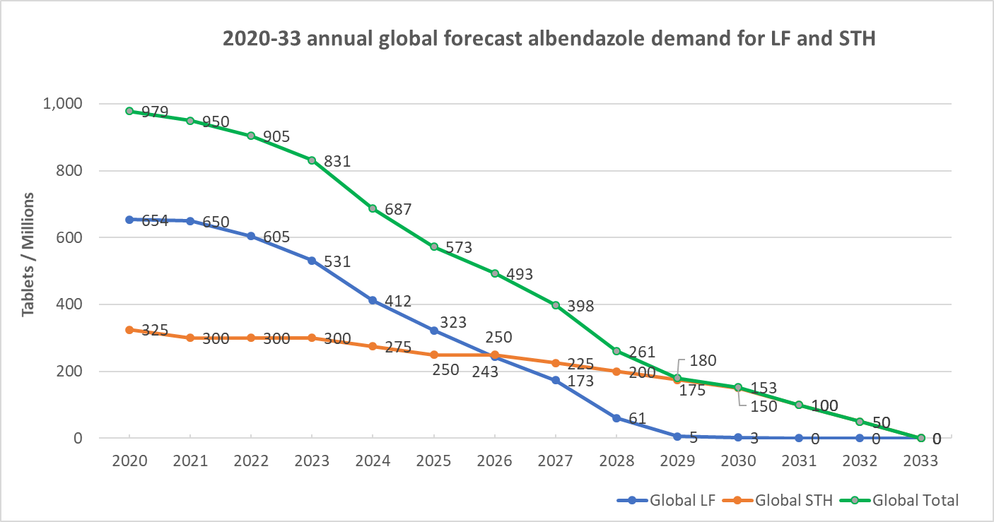
Global Demand Plan beyond 2020

Slide 8
