Slide 1

Update on LF activities
September 18, 2019
Liverpool, UK

Slide 2
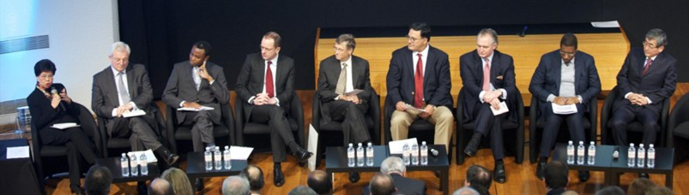
“London Declaration” (2012)
The Largest PPP Ever Made
Goal: Aim at eliminating 10 NTDs by 2020
Participant: Bill & Melinda Gates Foundation, World Health Organization (WHO), the World Bank, the U.S. and U.K. Governments, Governments of countries endemic for NTDs, charitable institutions, 13 pharmaceutical companies and a diagnostic company
Progress (2012-2017): Provided approx. 7 billion treatments free of charge since 2012
(Far left: WHO Director General Dr. Margaret Chan, Middle: Bill Gates, Bill & Melinda Gates Foundation, Far right Haruo Naito, Eisai)
2

Slide 3
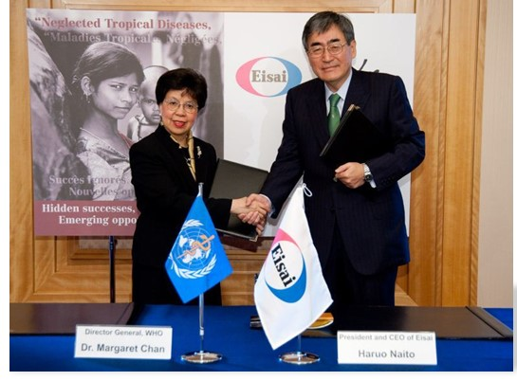
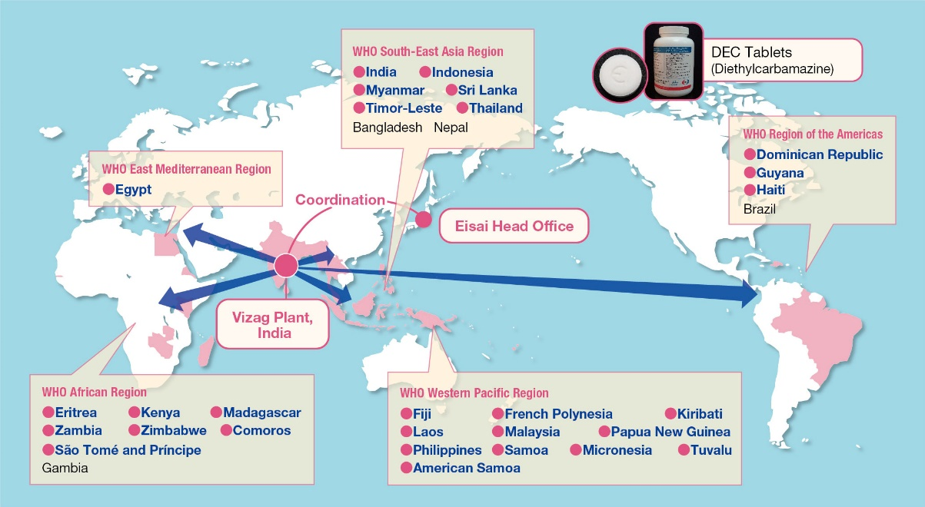
Commitment to WHO’s Global Programme to Eliminate Lymphatic Filariasis (LF)
Signed an agreement in 2010 to provide 2.2 billion DEC (diethylcarbamazine) tablets at price zero to WHO
First public–private partnership (PPP) to be established between a Japanese pharmaceutical company and WHO to eliminate an NTD
High quality manufacturing at Eisai facility in Vizag, India (WHO pre-qualification)
Signing Ceremony with WHO Director General Dr. Margaret Chan on November 18, 2010
Planning to distribute DEC tablets
●: Already distributed
Distribution status
as of August 2019:
1.9 billion tablets
to 28 countries
Recently, 15 countries approved by WHO
for LF elimination

Slide 4









GHIT Fund (2013)
The World’s First Product Development Fund for Global Health
Global Health Innovative Technology Fund
Founders
        Government
        Companies
Global
Organization
Goal：Eliminate NTDs, HIV/AIDs, Malaria and Tuberculosis (TB) by developing new drugs, vaccines, and diagnostics based on Japanese technologies and innovations, including collaborative arrangements with overseas institutions
  Total investment
  First Term: 13 billion yen (2013-2017), Second Term: 4 billion yen (2018-)
Number of ongoing projects
Discovery: 22, Pre-clinical: 14,
Clinical: 8 (3 for Malaria, 2 for TB, 1 for Chagas,
1 for Mycetoma, 1 for Schistosomiasis)

Slide 5



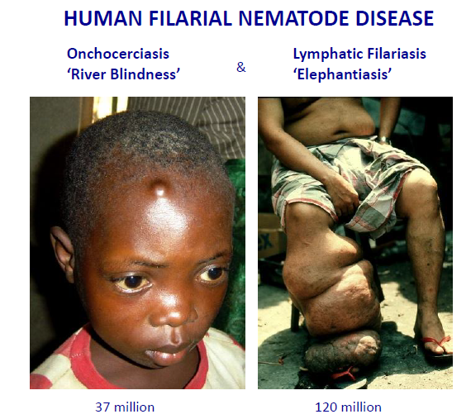
Safe Macrofilaricides for Filariasis
Filarial nematode worms contain the mutualistic endosymbiotic bacteria Wolbachia
Wolbachia are essential for larval development, embryogenesis and adult worm survival
Adult worm longevity is 10-14 years for Onchocerciasis and 5-8 years for Lymphatic Filariasis
Wolbachia depletion provides Macrofilaricidal activity with adult worm death occurring in 1-2 years
Macrofilaricidal activity without the toxicity caused by directly acting anthelminthics
POC with 4-6 week doxycycline in multiple clinical trials
Potential to deliver disease elimination - A∙WOL strategy adopted by elimination programmes
Current A∙WOL treatment options limited by dosage regimen and contraindications
2.5M compounds screened (including BioFocus library of >10,000 compounds) against Wolbachia at LSTM by A∙WOL
>20 Hits series identified
6 hit chemotypes were selected for onward progression and lead optimisation
Candidate selected from Series 1

Slide 6

Template 1: Thienopyrimidine/ (Aza)Quinazoline
Medchem optimization: studied SAR and improved DMPK
Translation between in vitro and in vivo anti-Wolbachia activities.
Lead evaluation and candidate selection.
Template 1
Thienopyrimidine/
(Aza)Quinazoline

Slide 7
BG109 ADULT Lito. screening
PCR readout: Wolbachia level
Drug Dose / duration | % Wolbachia reduction*
DOX 40MKbid +14d | 88.35
AWZ1083 150MKbid+07d | 99.91
AWZ1083 100MKbid+07d | 99.91
AWZ1083 50MKbid+07d | 99.78
AWZ1084 150MKbid+14d | 99.76
AWZ1084 100MKbid+07d | 99.80
AWZ1084 50MKbid+07d | 99.80
AWZ1084 25MKbid+07d | 88.84
*cf median Vehicle
AWZ1066R
AWZ1066S
Kruskal-Wallis 1 way ANOVA P<0.0001 Dunn’s multiple tests vs DOX***P<0.001
No significant differences in worm burden in all tested groups.

Slide 8
In Vivo efficacy study summary
PD model |  | AWZ1066 | AWZ1066S | AWZ1066R
Brugia | Larval | 99.91% (100mg/kg, bid, 14-day) | ND | ND
 | Adult | 98.8% (100mg/kg, bid, 14-day) | 97.8% (100mg/kg, bid, 7-day) | 99.6%/99.7% (100mg/kg, bid, 14-day/ 150mg/kg, bid, 7-day)
Litomosoides | Larval | 99.99% (50mg/kg, bid, 14-day) | 99.99% (50mg/kg, bid, 7-day) | 99.99% (50mg/kg, bid, 7-day; 25mg/kg, bid, 14-day)
 | Adult | ND | 99.8% (50mg/kg, bid, 7-day) | 99.8% (50mg/kg, bid, 7-day)
O Ochengi | Adult | ND | 95.7 (100mg/kg, bid, 14-day) | ND
Loaloa | mf | ND | 0% depletion/ 0 lethality (150mg/kg, bid, 2-day) | ND

Slide 9






1066S: A Macrofilaricidal agent for the elimination of Lymphatic Filariasis and Onchocercasis
Farid Benayoud
Tomoyuki Moriyama
Vaishali Dixit
Raku Shinkyo
Vijay Gupte
Anil Kihle
Keiko Onuma
Nobuya Suzuki
Yvonne vanGessell
Satish Dayal
Toshiharu Yanagi
Frank Fang
Amy Siu
George Lai
Motohiro Shiotani
Steve Ward
Mark Taylor
Paul O’Neill
David Hong
Joseph Turner
Susan Jones
Gemma L. Nixon
Louise Ford
Marc P. Hübner
Achim Hoerauf

Slide 10
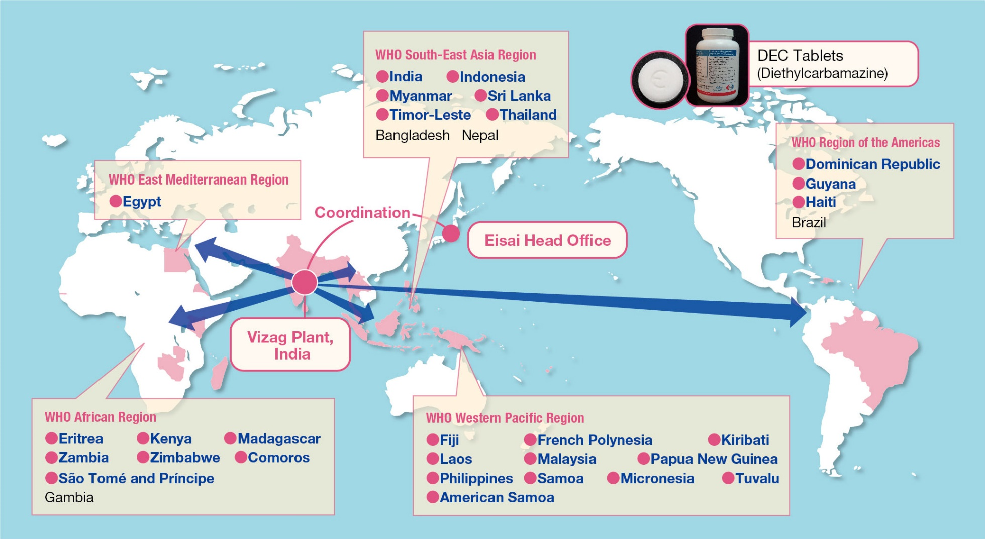
Current Distribution Status
of DEC Tablets for Endemic Countries
Distribution status as of August 2019:
1.9 billion tablets for over 760 million people in 28 countries
WHO recognized 15 countries have achieved LF elimination
Cambodia, Cook Islands, Niue, Vanuatu, Marshall Islands, Tonga, Palau, Vietnam,
Wallis and Futuna, Sri Lanka, Maldives, Thailand, Togo, Egypt and Yemen

