Slide 1
NNN - LF SCORECARD/ACTION FRAMEWORK UPDATE
Dr. Francisca Olamiju
Action Framework representatives for LF group
18th September 2019

Slide 2
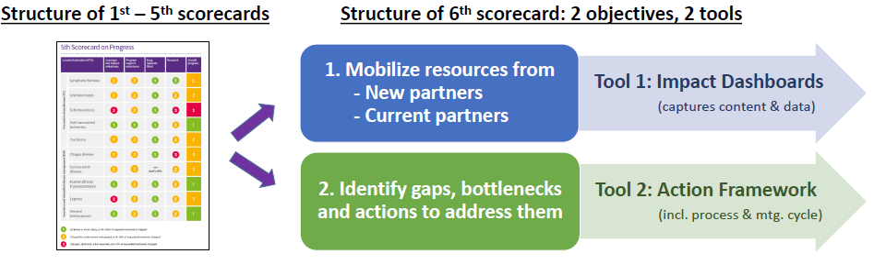
NTD Scorecard Update
Scorecard reviewed in 2017 – two distinct objectives identified and lead to suggestions on new format and content
2018 – Scorecard divided into two annual tools; the Impact Dashboard and Action Framework

Slide 3
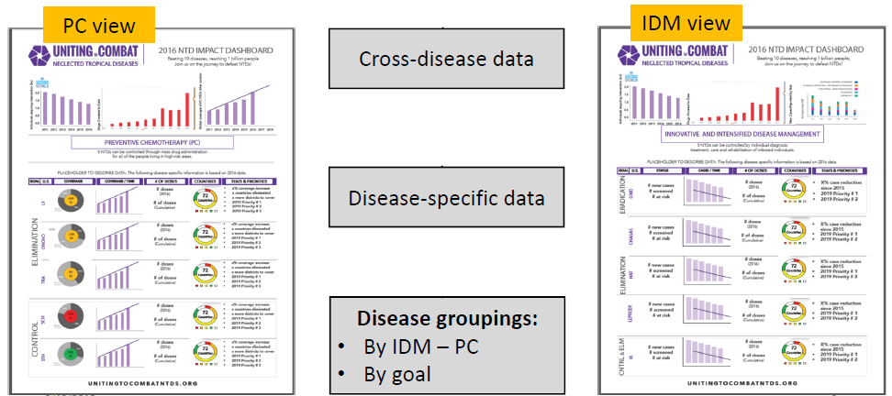
Objective 1: Mobilize resources from new and current partners (Tool: Impact Dashboard)
For current partners with content requested by major donors and stakeholders
Uses WHO quantitative progress indicators
Follows progress across multiple diseases in one view with common measures

Slide 4
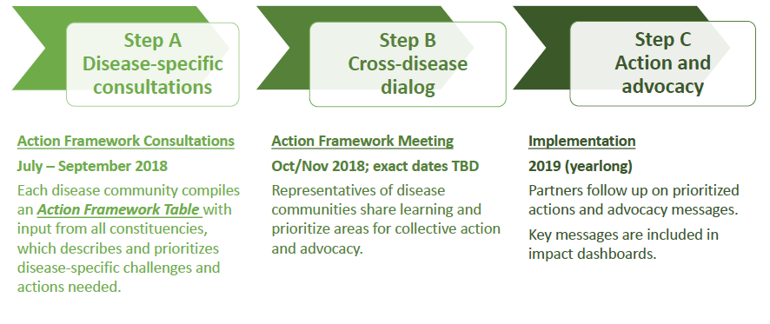
Objective 2: Identify gaps, bottlenecks and actions to be addressed (Tool: Action Framework)
Input provided by constituents directly into the framework regarding the three pillars; Enabling Environment, Strategy, and Public Health Intervention.
  Identify gaps, bottlenecks and collective actions.
  Strengthen NTD partnership through engaging on progress and gaps across 10 diseases
October 10-11, Geneva

Slide 5
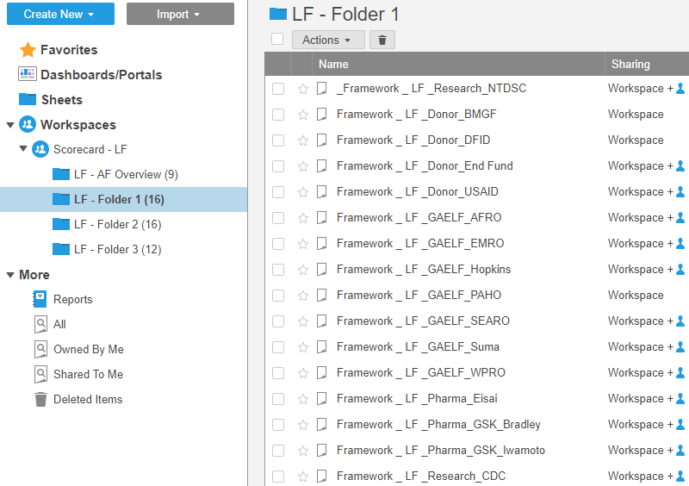
Completing the Framework – Partners Contributions
Action Framework Smartsheet was shared with 48 LF constituents at the end of August (LF NGO Network)
9 have provided feedback which has been entered into the framework
  Enabling environment like healthcare financing
  Health information system
  Access to medical products
  Health workforce
  Scientific understanding
  Operational guidelines
  Service delivery
  Sustaining Impact, amongst others
PARTNER CONTRIBUTIONS ARE CURRENTLY
BEING CONSOLIDATED

Slide 6
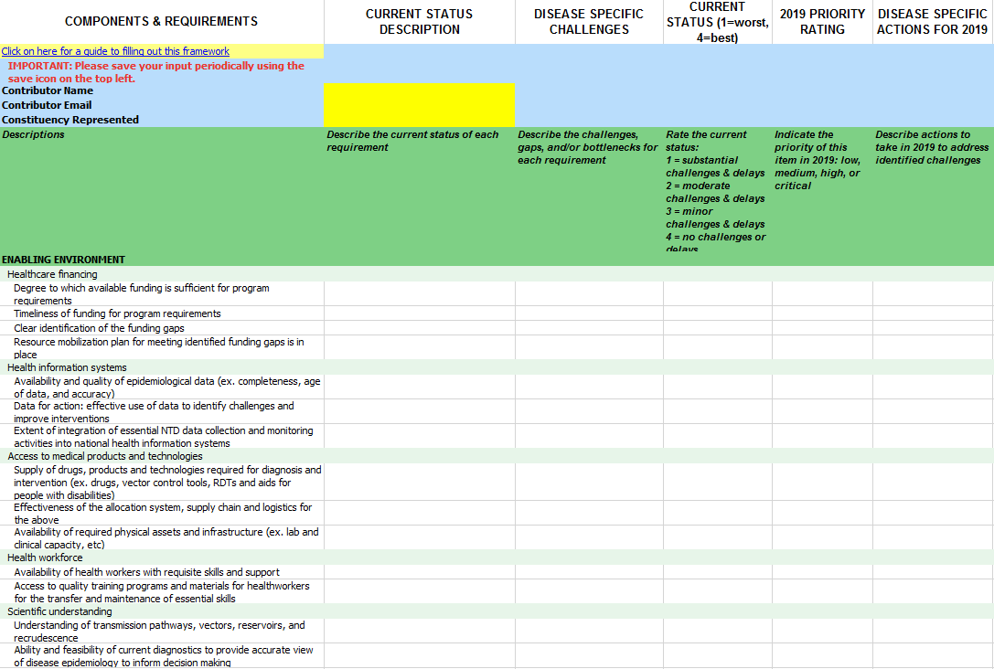
Action Framework – at a glance
Contains 3 pillars and 11 components
32 requirements for comment
Additional sections can be added

Slide 7
2019 update
*UTCNTD dashboard has been finalized and the link has been shared.
*The UTCNTD 2018 Action framework report is out and shared.
The final UTCNTD Action Framework report was recently finalized, the link is
https://unitingtocombatntds.org/impact-dashboards/pc-diseases-dashboard/

Slide 8
Thank you

