Slide 1
American Leprosy Missions | The AIM Initiative
Stefanie Weiland
Vice President of Special Initiatives
September 18, 2019

Slide 2
American Leprosy Missions
Mission: to serve as a channel of Christ’s love to persons affected by leprosy and related diseases, helping them to be healed in body and spirit and restored to lives of dignity and hope.

Slide 3
ALM Overview
Christian global health and development organization serving vulnerable people affected by NTDs
Since 1906, provided holistic care for more than four million people in 42 countries
Global staff of 34 people and annual budget of $20M (FY18)
Network of more than 50 partners
Research and implement innovative and scalable programs
AIM Initiative started in 2016
ALM serves people affected by high-morbidity NTDs

Slide 4
ALM Global

Slide 5
The AIM Initiative: Program of ALM
AIM partners with MOH to strengthen their ability to use data, integrate strategies and systems, target resources, and improve access to care for people suffering from high-morbidity NTDs.

Slide 6
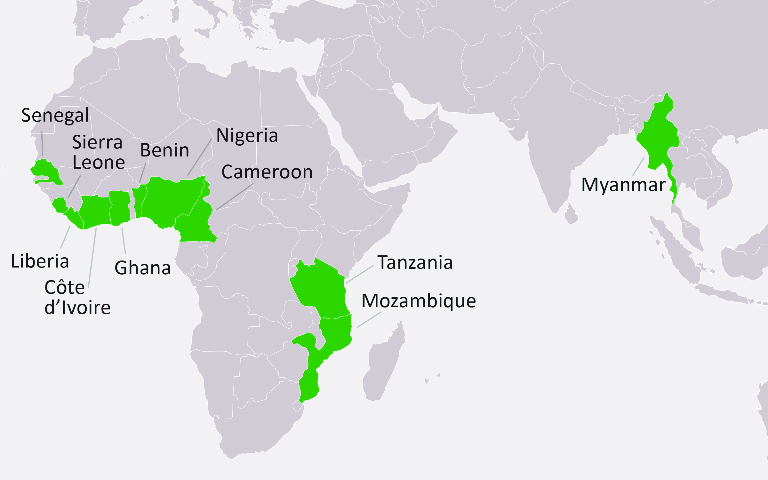
Where We Work

Slide 7
Global Challenge
Different disease control programs responsible for case management NTDs
Lack of clear and accessible data
Limited resources
Delayed diagnosis increases cost of treatment and management

Slide 8
AIM Approach and Supported Activities

Slide 9
Key Achievements: Results
In the first 12 months of implementation, an increase of 320% of NTD cases were recorded, compared to the previous year.

Slide 10
Key Achievements
Integrated disease burden maps including LF morbidity data in 5 countries and strategic case management plans in 4 countries
Rigorous disease burden assessment in Maryland County, Liberia
COR-NTD operational research in Liberia and Ghana investigating models of case identification, referral, and treatment for LF (and select other diseases)
Successful ALM WASH & NTD case management integrated programs in Asia targeting reduced infection

Slide 11
AIM Current Issues & Upcoming Activities
USAID Act to End | West consortium with FHI 360, World Vision Intl., Hellen Keller Intl., Americares, Health and Development Intl., and Deloitte Consulting
Ghana, Côte d’Ivoire, Senegal, Benin (LF)
Morbidity management requirements of WHO elimination dossier
Country-strategic planning for MMDP
Cameroon:
Validate integrated strategic plan and support national program implement OCEAC-funded activities (case search, integrated data management and case management)
Liberia: REDRESS (NIHR) project with LSTM
Test and validate multidisciplinary results in integrated case management of severe stigmatizing skin diseases including LF

Slide 12
Contact: Stefanie Weiland, VP of Special Initiatives sweiland@leprosy.org +1 314-537-1012 Skype: slynette1
leprosy.org
aiminitiative.org

