Slide 1
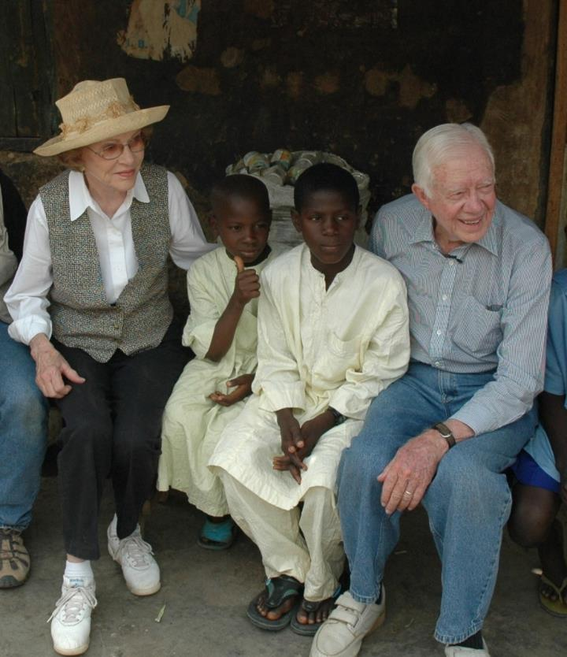
Rapid Fire updates from selected partners (achievements and current issues)
LF NGDO Network Meeting
NNN 2019 Conference
Liverpool, United Kingdom
September 18, 2019
Dean G. Sienko, MD, MS
Vice President
Health Programs

Slide 2
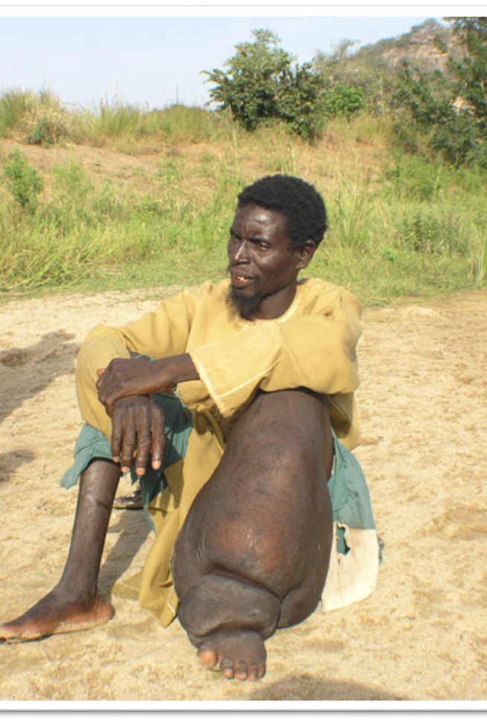

Lymphatic Filariasis Elimination Program
Nigeria is the most LF-endemic country in Africa
  Second most endemic in the world (India)
  120 million people at risk of infection
Eliminated in two states, October 2017
  Nasarawa and Plateau (Pop. 7 million)
  14,230 children ages 6 - 7 tested in TAS-3: Zero (0%) positive for LF antigenemia (FTS)
  Adults and entomology also parasite-negative

Slide 3
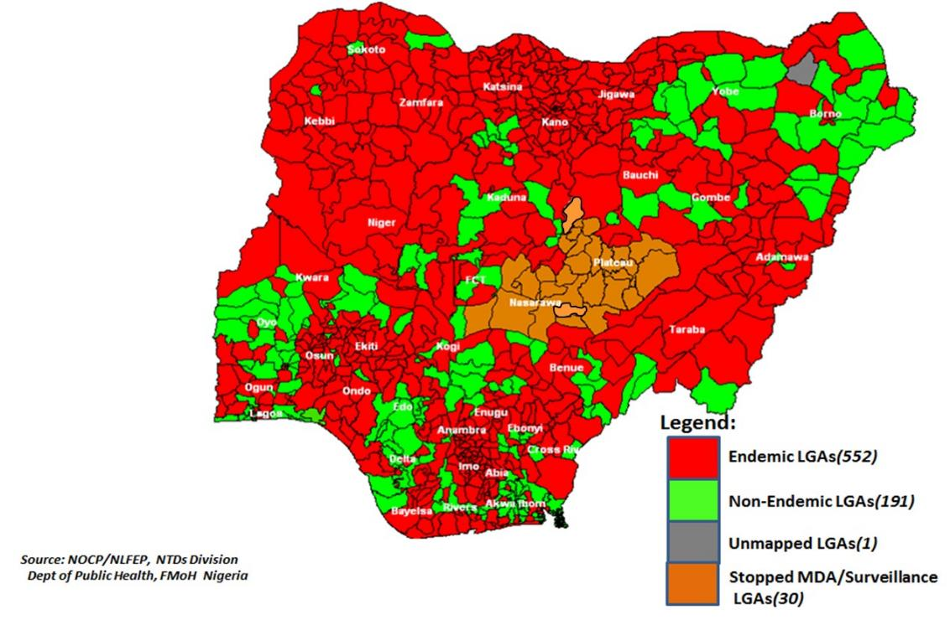
LF Prevalence in Nigeria: December 2017

Slide 4
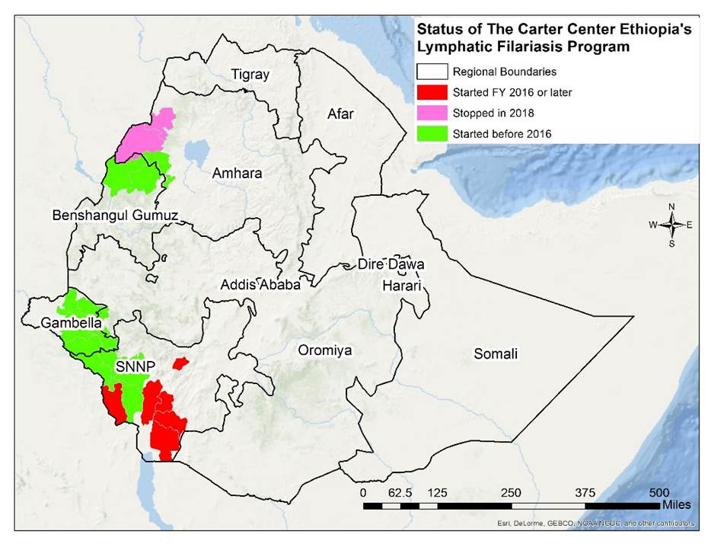

Slide 5
Lymphatic Filariasis - Hispaniola
10 million people at risk.
258,808 people at risk.
LF baseline mapping

Slide 6
Lymphatic Filariasis - Hispaniola
LF MDA Status, Dec 2018
100%
84%

Slide 7
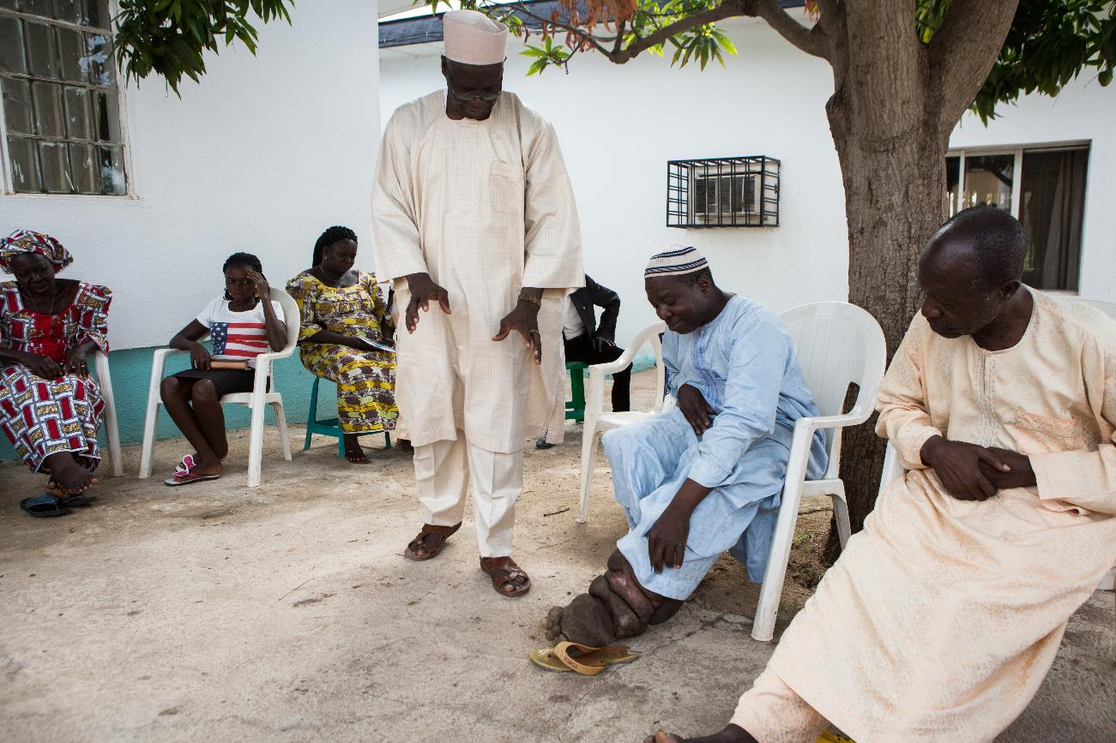
Hope Group
(Jos, Nigeria)
John Umaru

Slide 8
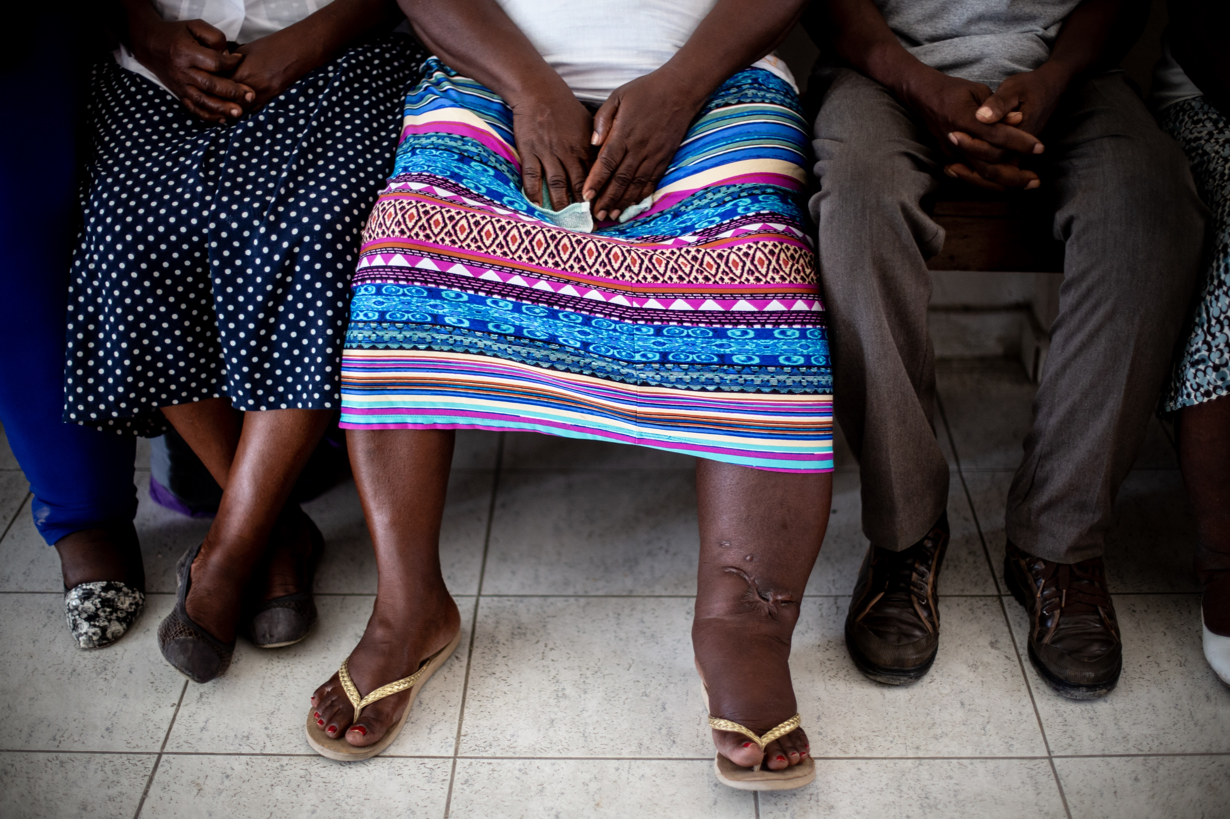
Integrating Mental Health Care with LF Morbidity
A pilot project in Leogane, Haiti in collaboration with Hôpital Ste. Croix & Univ. of Notre Dame.
Evaluate the effect of delivering Chronic Disease Self-Management (CDSM) curriculum to Hope Clubs.
CDSM trains people living with chronic disease to facilitate group education and skill building sessions; strengthens internal locus of control, self-confidence, and skills like health literacy.
CDSM sessions for intervention arm expected to start Sept. 2019.
20% of LF patients met criteria for depression
-Obindo et al., 2017 PLoSNTD

