Slide 1
Rapid fire LF updates
Abdel Direny, MD-MPH
Sr Technical Advisor
LF NGDO Networking meeting
Liverpool, September 2019

Slide 2



Vision and Mission statement
IMA’s Vision: Health, healing and well-being for all
IMA’s Mission: To build healthier communities by collaborating with key partners to serve vulnerable people

Slide 3
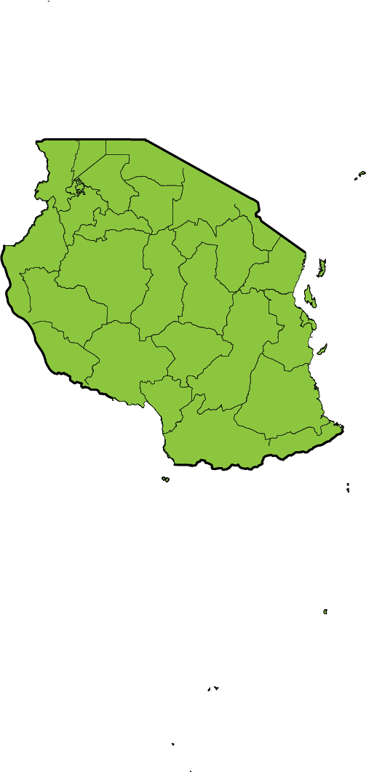
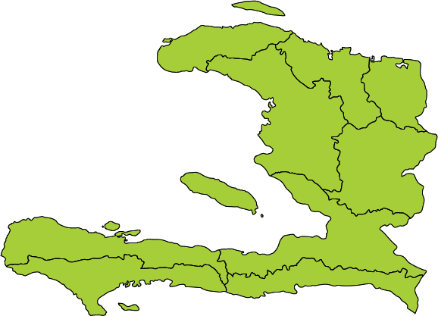
Countries covered
Haïti
Tanzania

Slide 4
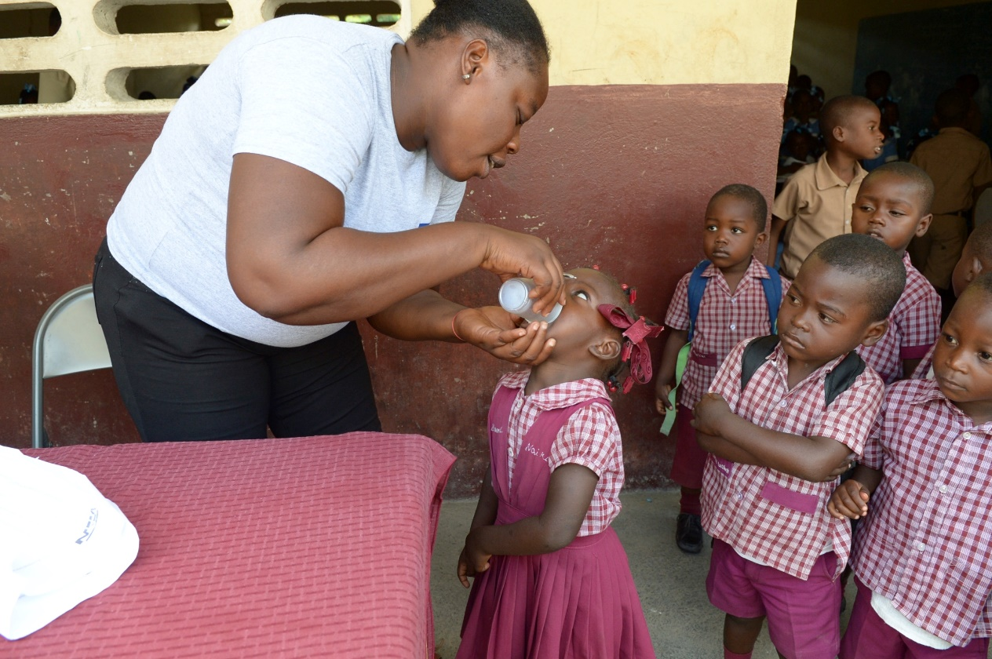
Key LF activities in FY19
MDA
Haiti
12 districts
83 % of supported
districts achieved
effective EPI coverage

Slide 5
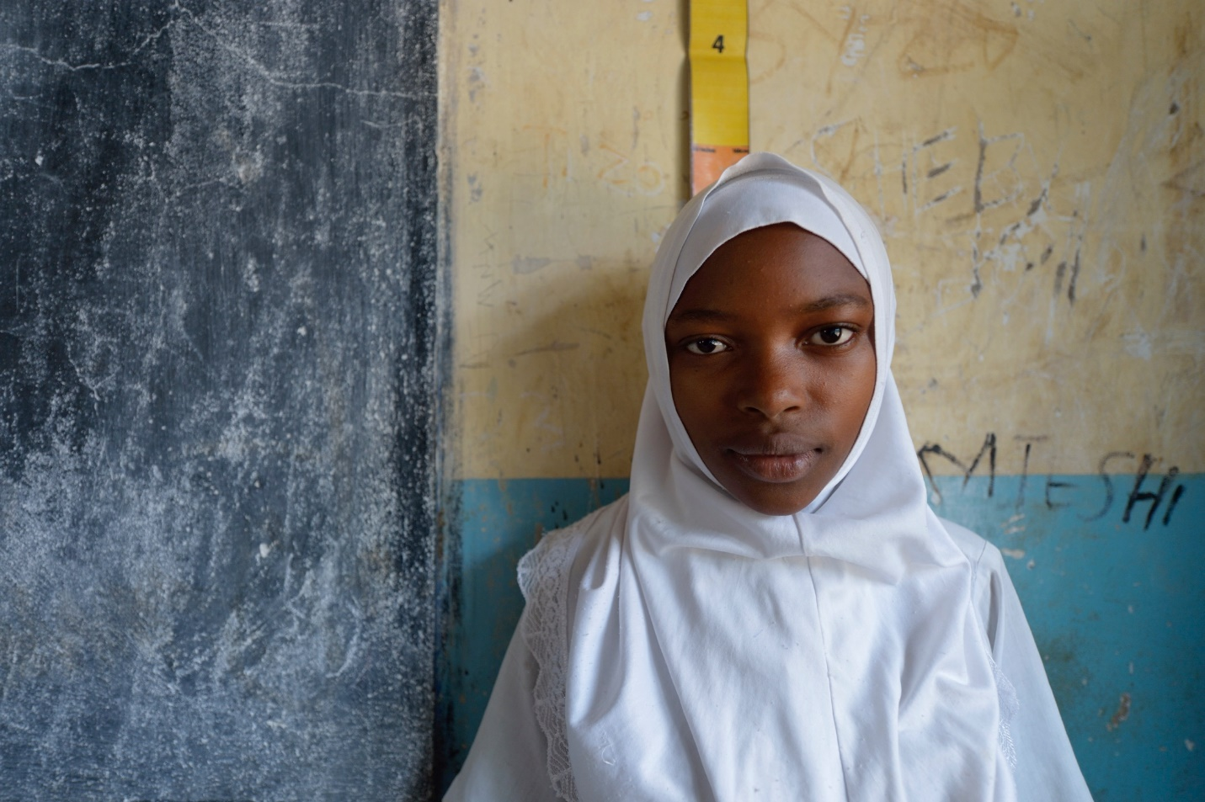
Key LF activities in FY19
MDA
Tanzania
9 districts (MDA is ongoing)

Slide 6
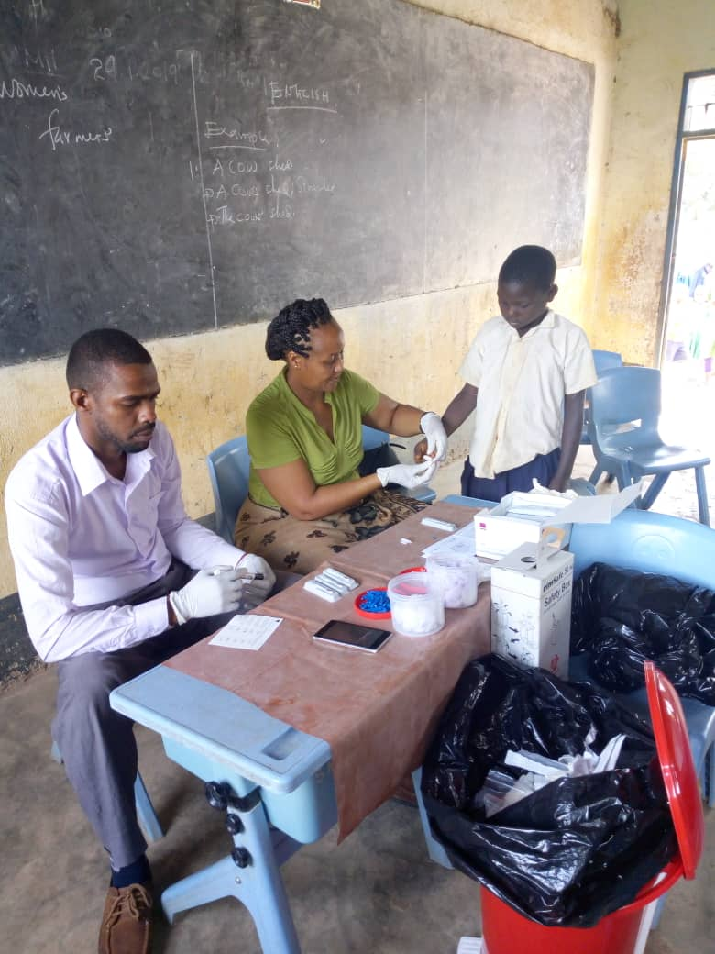
Key LF activities in FY19
Pre-TAS, TAS1, TAS2, coverage survey
Haiti
Pre-TAS: 8 IUs
(3 IUs passed; 5 IUs failed)

Slide 7
Key LF activities in FY19
Pre-TAS, TAS1, TAS2, coverage survey
Tanzania
Pre-TAS: 10 IUs, 9 IUs passed, 1 IU failed
TAS1: 9 EUs, all EUs passed and stopped MDA
TAS2: 20 EUs, all EUs passed
TAS3: 6 EUs, all EUs passed

Slide 8
Activities
Training (CDDs, MOH)
Microplanning
Social mobilization (press conference, radio &TV spots, banners, flyers, etc….)
MDA (supervision, data collection)
Supervisor’s coverage tool (SCT)
Monitoring and Evaluation
  Pre-TAS
  TAS (TAS1, TAS2)
  Coverage survey
Dossier development
Operational research
  IDA trial
  Positive case follow up during TAS
Advocacy
MMDP (Situation analysis, burden assessment)

Slide 9
Upcoming activities
MDA (9 districts in TZ, 17 districts in Haiti)
Post-MDA coverage survey
DSA: pre-TAS, TAS1-TAS2-TAS3
Learning activities in failure DSA district
IDA implementation
Dossier development (review data, narrative write-up)
2-3 LF manuscripts
Pilot the new WB123 RDT (version 2.0) with support from TFGH

Slide 10
Challenges
Denominator concerns
Security issues / Civil unrest
Hard-to-reach populations
Pre-TAS and TAS failures after > 5 rounds of MDA
Cross-border surveillance
Lack of funding for MMDP

Slide 11
Thank you

