Slide 1

Lymphatic Filariasis (LF)
Non-Governmental Development Group (NGDO)
Dr Louise Kelly-Hope, Chair LF NDGO Group

Slide 2
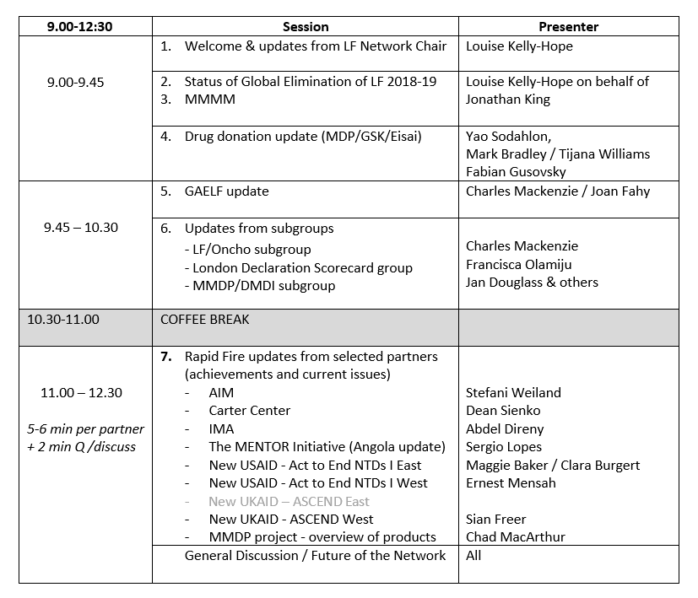

Slide 3
LF NDGO Network
Aim of facilitating integration and collaboration among NGDOs supporting LF elimination
Objectives:
  To serve as a forum for information sharing, collaboration, and communication
  To provide LF technical input, on tools, resources, meetings, workshops, other important initiatives
  To provide technical guidance and support to the NNN on LF-related discussions and initiatives, with the goal to achieve 2020 targets
  To serve as the link between the NGDO community to the GAELF, and help amplify the advocacy and communication efforts

Slide 4
LF NDGO Network
Past Chairs
Susan Girois (Handicap International), Jose de La Cruz (LEPRA), Pierre Brantus (Handicap International), Ann Varghese (IMA World Health), Emily Toubali (HKI), Molly Brady (RTI) and Yao Sodahlon (MDP)
Current Chair: Louise Kelly-Hope (CNTD/LSTM)
Vice Chair: Paul Watson (LEPRA)
Immediate Past Chair: Yao Sodahlon (MDP)
LF - Oncho sub-group lead: Charles Mackenzie (TFGH)
LF - MMDP sub-group lead: Jan Douglass (CNTD/LSTM)
London Declaration Scorecard Working Group rep: Francisca Olamiju (MITOSATH)

Slide 5

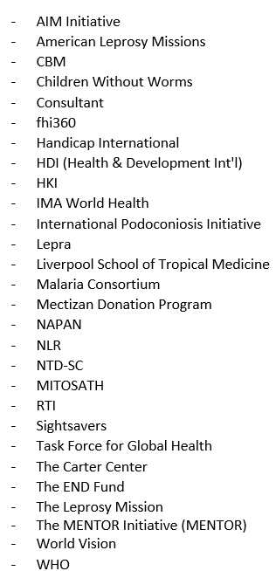










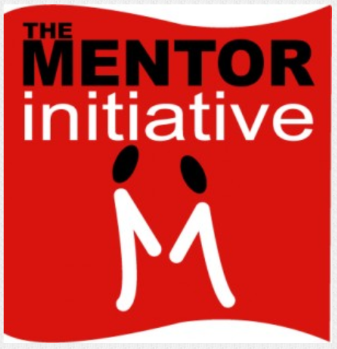




















Institutions / Organizations
- Uniting to Combat NTDs
- GAELF
Notes:
Indian Network LF MMDP program

Slide 6
Survey - key themes 2018
MDA
Working together to bridge MDA gaps in target communities / getting coverage everywhere
Workshop on the scale-up of Triple Drug (IDA) MDA
Coordinating LF and oncho / stopping MDA in Africa for the endgame
Improving community participation during MDA through drama and public engagement
MMDP
How LF programmes are strengthening the health system to provide patient care
Good care practices by the person affected, their family and community to sustain disease prevention and improve quality of life
WHO requirements for the MMDP component of the dossier
Hydrocele surgery technical and programmatic updates

Slide 7
Survey - key themes 2018
Other
Strengthening capacity in integrated vector management
Impossible to reach? NTDs in Conflict and Emergency Settings
What will be the target post-2020?
How to deal with programme fatigue?
Country examples of achieving sustainable post-MDA surveillance
NTDs and cross border situations
Current role and contribution of LF NGDO to the GPELF
NDGO/Partner mapping and identifying GAP countries

Slide 8
